Slide 1



Immunotherapy in cancer
Oscar Arrieta MD
Thoracic Oncology Unit
National Cancer Institute of Mexico

Slide 2
Financial Disclosures
Employment or Leadership Position: None
Advisory Role or Expert Testimony: Novartis, Bristol, BI, Roche, Lilly, Merck, Asofarma, Amgen, AstraZeneca
Stock Ownership: None
Patent, Copyright, Licensing: None
Honoraria: None
Financing or Scientific Research: Bristol, AstraZeneca, Merck, Roche
Other Financial Relationships: None

Slide 3
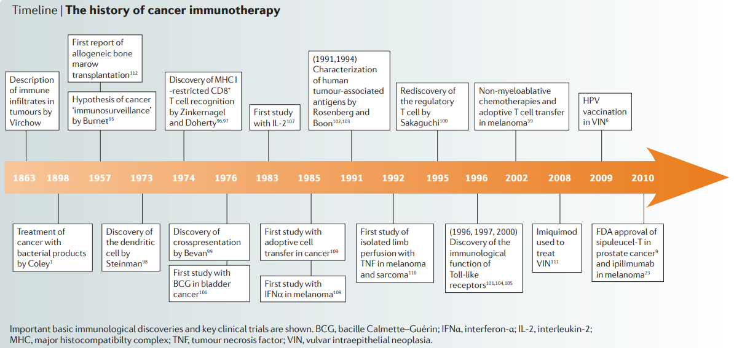


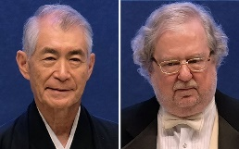
Cancer Immunotherapy (IT) origin and evolution
Immunotherapy is a form of cancer treatment that uses the power of the body's immune system to prevent, control, and eliminate cancer, ranging from preventive vaccines to monoclonal antibodies and cellular therapies.
1898
William Coley
2018
Tasuko Honjo
James P Allison
Lesterhuis, W. J., Haanen, J. B. A. G., & Punt, C. J. A. (2011). Cancer immunotherapy – revisited. Nature Reviews Drug Discovery, 10, 591.

Slide 4
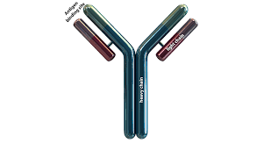

Immunotherapy (IT) strategies against Cancer
Types of immunotherapy that help the immune system act directly against the cancer include:
Immune Checkpoint Inhibitors (ICIs)
Adoptive cell transfer
Monoclonal antibodies
Treatment vaccines
Types of immunotherapy that enhance the body’s immune response to fight the cancer include:
Cytokines
BCG
NIH-National Cancer Institute, USA, 2019.

Slide 5
Cancer Immunity Cycle drives the underlying biology of immuno-oncology
1
Neoantigen generation
Tumor cells generate neoantigens as a result of genetic alterations
These neoantigens are recognized by the TCR of immune cells, resulting in immune cell activation and proliferation
4
Other
There are other biology approaches being investigated including the microbiome’s impact on the modulation of the tumor microenvironment
The microbiome can influence immune responses to tumors through regulating metabolism, hematopoiesis and inflammation
4
Cancer Immunity Cycle
2
Immune activation
Recognition of tumor cell neoantigens leads to immune activation, immune cell proliferation, and subsequent attack on the tumor
Immune evasion
Tumors have a number of mechanisms to evade attack by the immune system including:
  Presenting checkpoint markers to evade recognition as a foreign entity by immune cells
  Recruiting regulatory cells that suppress immune cell killing ability
3
Chen & Mellman’s ‘The Cancer-Immunity Cycle’ (2013)

Slide 6
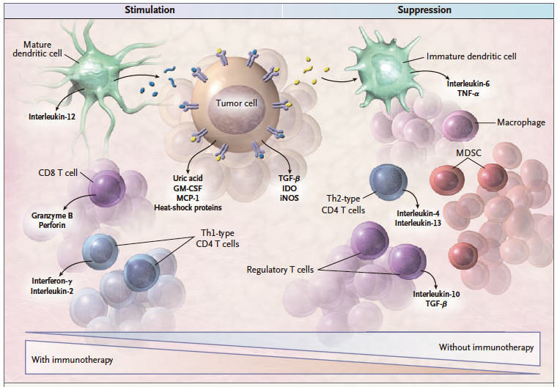
Notes:
A growing tumor attracts many components of the host response. Tumor antigens and soluble tumor products attract dendritic cells to
the tumor site. These dendritic cells take up tumor antigens, mature into interleukin-12–producing cells, and in the draining lymph node
stimulate type 1 helper T-cell (Th1)–type CD4 T cells that produce interferon-γ. These cells help expand the population of CD8 cytotoxic
T-lymphocytes that can destroy tumor cells through effector molecules granzyme B and perforin. Another set of tumor antigens and soluble
tumor products promote maturation of a different type of dendritic cell that makes proinflammatory cytokines interleukin-6 and tumor
necrosis factor α (TNF-α) and give rise to type 2 helper T-cell (Th2)–type CD4 T cells that make interleukin-4 and interleukin-13 and
are not effective in tumor rejection. This immunosuppressive environment also promotes generation of regulatory T cells and accumulation
of macrophages and myeloid-derived suppressor cells (MDSC). At the time the tumor is diagnosed, the balance between the stimulatory
and suppressive forces is in favor of tumor-induced suppression. Immunotherapy that targets the tumor with antibodies and T
cells or augments antitumor Th1-type CD4 helper T cells and cytotoxic T lymphocytes with vaccines can tip the balance in favor of immunostimulation.
GM-CSF denotes granulocyte–macrophage colony-stimulating factor, IDO indolamine-2,3-dioxygenase, iNOS inducible
nitric oxide synthase, MCP-1 monocyte chemotactic protein 1, and TGF-β transforming growth factor β.

Slide 7
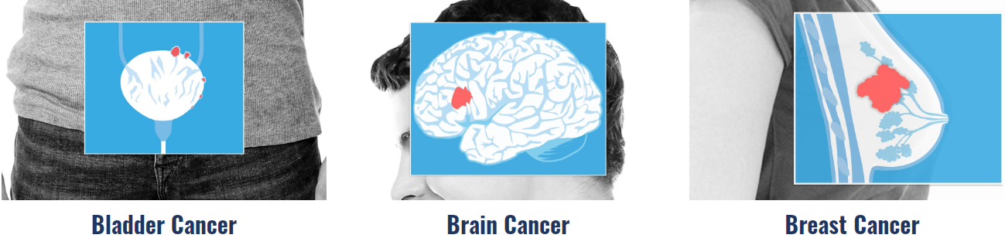
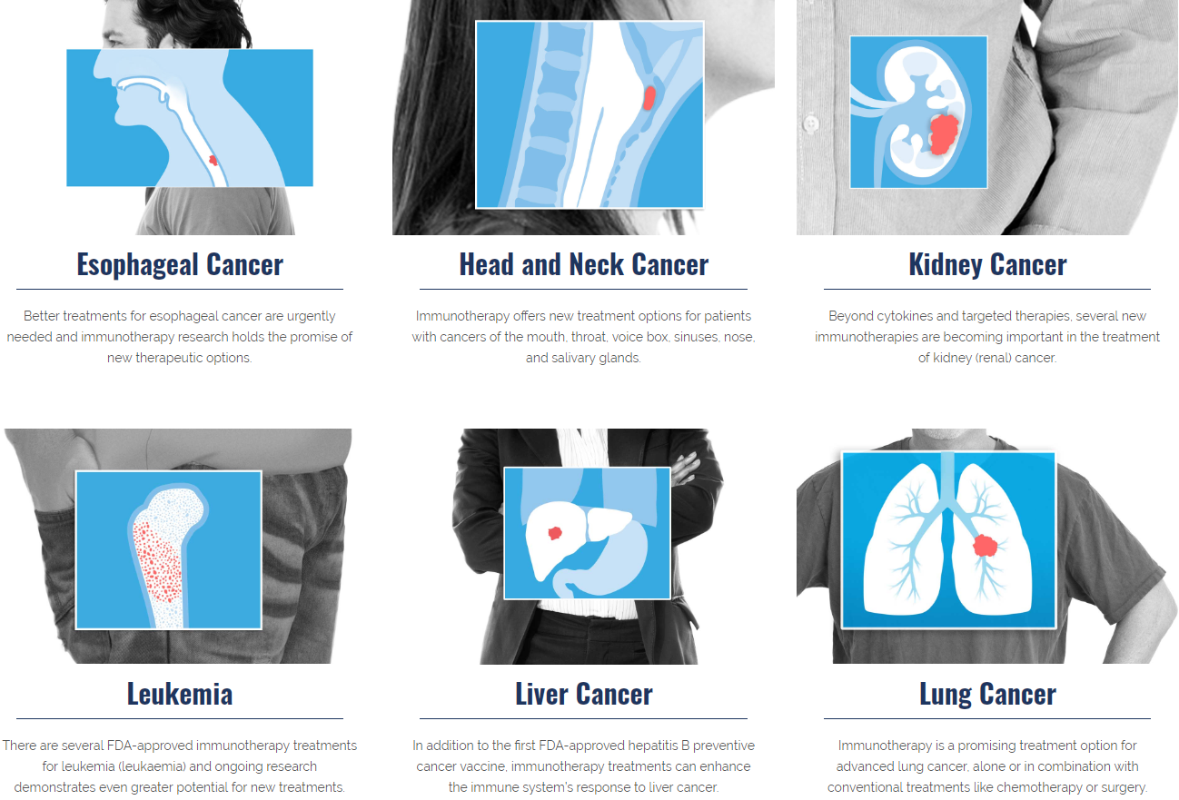
Immunotherapy for different cancer types
Every cancer type is unique, though, immunology and immunotherapy are impacting each cancer in different ways.
Currently, the FDA has approved Immune Checkpoint inhibitors (ICIs) for
Non Small Cell Lung Cancer
Melanoma
Advanced Esophageal Cancer
Triple Negative Breast Cancer
Metastatic Colorectal Cancer
Cervical Cancer
Bladder Cancer
Advanced Kidney Cancer
Cancer Research Institute, Immunotherapy by Cancer type.

Slide 8
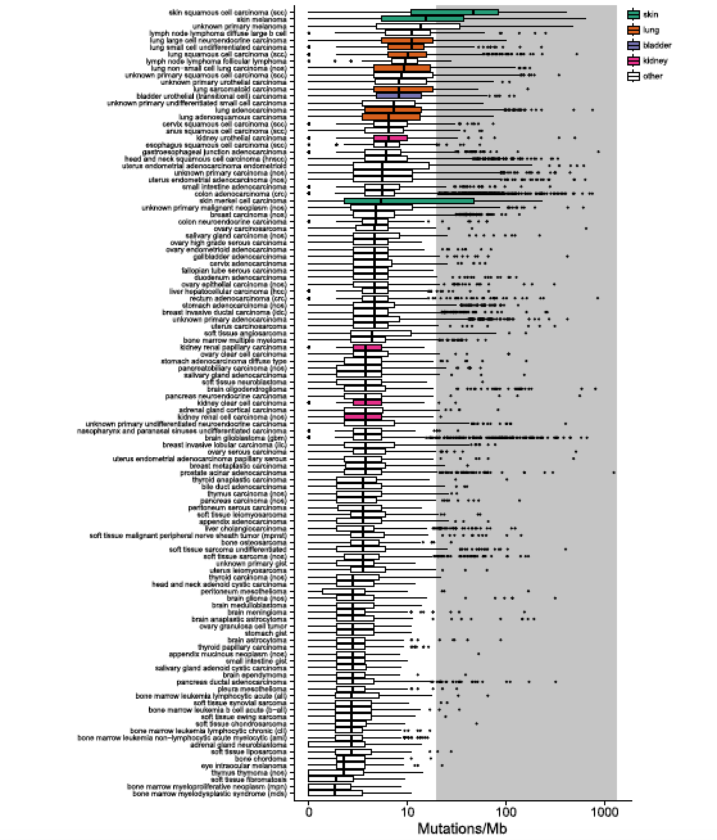
Analysis of 100,000 human cancer genomes reveals the landscape of tumor mutational burden
A significant number of disease types, including those not currently approved for checkpoint inhibitors, have outliers with TMB exceeding 20 mut/Mb
Skin
Lung
Bladder
Kidney
other
← Disease type →
Chalmers ZR, Connelly CF, Fabrizio D, et al.. Genome Med 2017; 9: 34.

Slide 9
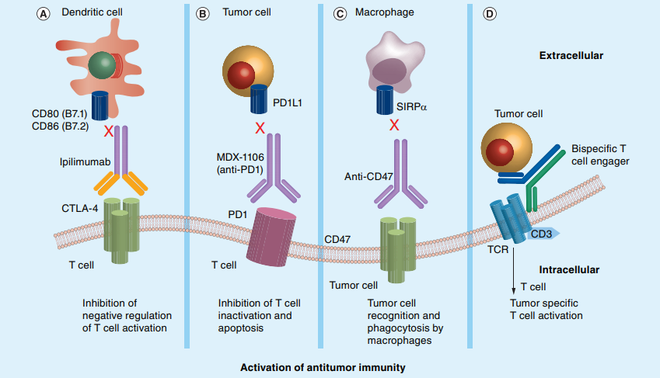
Antibody based Immunomodulatory strategies against Cancer
Anti PD1
Pembrolizumab
Nivolumab
Cemiplimab
Anti PD-L1
Atezolizumab
Durvalumab
Avelumab
Types of Immune Checkpoint inhibitors (ICIs)
Anti CTLA4
Ipilimumab
Tremelimumab
Helmy, K. Y., Patel, S. A., Nahas, G. R., & Rameshwar, P. (2013). Cancer immunotherapy: accomplishments to date and future promise. Therapeutic Delivery, 4(10), 1307–1320

Slide 10
The history of PD-L1 as a biomarker
PD-1 identified¹
PD-L1 and PD-L2 shown to be upregulated in some cancer cell lines⁴; PD-L1 on tumours can cause apoptosis of tumour-specific T cells⁵
Phase I-II trials suggest utility of PD-L1 as a biomarker for response to anti–PD-L1/PD-1 immunotherapy^{8–10}
1990
2000
2010
2017
Peter Linsley discovered the interaction between CD28, CTLA-4, and B7.
In 1992, Tasuku Honjo cloned the PD-1 gene (Pdcd1) from immune cell lines undergoing apoptosis.
Anti-PD-1/PD-L1 antibodies shown to inhibit tumour growth^{6,7}
Discovery of
PD-L1/PD-L2^{2,3}
First development and testing of primary antibodies for detecting
PD-L1 proteins by IHC analysis¹¹
1. Ishida Y, et al. EMBO J 1992;11:3887; 2. Freeman GJ, et al. J Exp Med 2000;192:1027; 3. Dong H, et al. Nat Med 1999;5:1365–9; 4. Latchman Y, et al. Nat Immunol 2001;2:261–8;
5. Dong H, et al. Nat Med 2002;8:793–800; 6. Iwai Y, et al. Proc Natl Acad Sci USA. 2002;99:12293–7; 7. Strome SE, Cancer Res 2003;63:6501–5; 8. Brahmer JR, et al. J Clin Oncol 2010;28:3167–75;
9. Thompson RH, et al. Cancer Res 2006;66:3381–85; 10. Mahoney KM, et al. Oncology (Williston Park) 2014;28(suppl 3):39–48; 11. Yu H, et al. J Thorac Oncol 2016;11:964–75
Notes:
From 1990 to 1991, Peter Linsley discovered the interaction between CD28, CTLA-4, and B7. The B7 pathway was later generally considered as an essential co-stimulatory molecule for naïve T cell activation.
In 1992, Tasuku Honjo cloned the PD-1 gene (Pdcd1) from immune cell lines undergoing apoptosis.
In 2000, Tasuku Honjo and Clive Wood discovered the interaction between B7-H1 and PD-1, and changed the name of B7-H1 to PD-L1.
In 2001, Arlene Sharpe and Gordon Freeman discovered another PD-1 ligand, PD-L2 (Programmed Death Ligand 2), which also shows inhibitory activity to T cells.
In 2004, Lieping Chen joined the Johns Hopkins University School of Medicine, and contributed to the development of the first-in-human trial concept on antibodies targeting the PD-1/PD-L1 pathway for the treatment of advanced cancers.
In 2006, the first human cancer clinical trial targeting the PD-1/PD-L1 pathway was launched in the Johns Hopkins Hospital.
In 2006, Lieping Chen’ s group developed a sensitive and effective immunohistochemistry staining protocol for detecting PD-L1 expression in cancer cells, and pointed out the value of PD-L1 staining in tumor sections on the prediction of anti-PD-1/PDL1 clinical efficacy in 2012

Slide 11
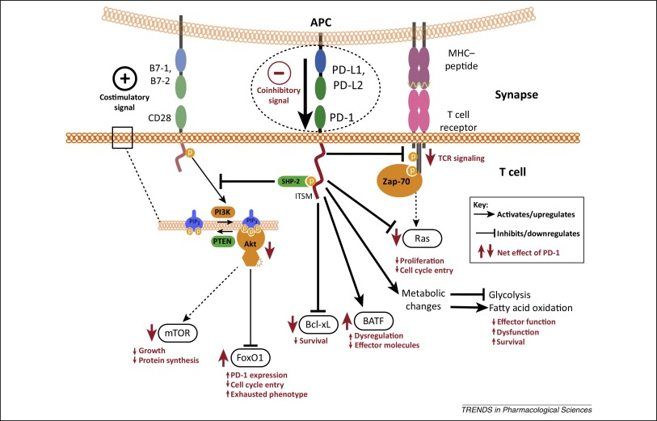
Activation of PD-1 by PD-L1
Decrease
Activation of TCR
Stimulation signal of CD28
Prolifeation
Fatty acid Oxidation
Cell Cycle entry
Effector molecules
  INF gama
Protein synthesis
Increase
Apoptosis
Exhausted phenotype
PD-1 expression

Slide 12
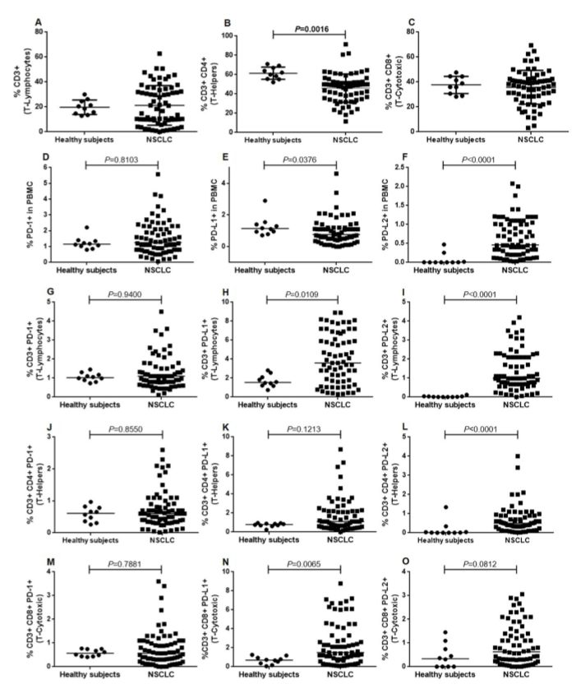
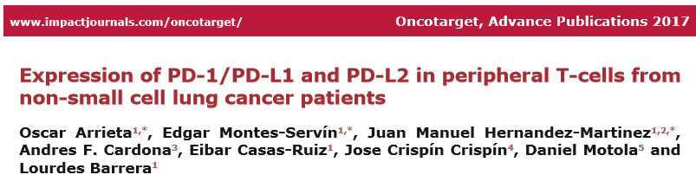
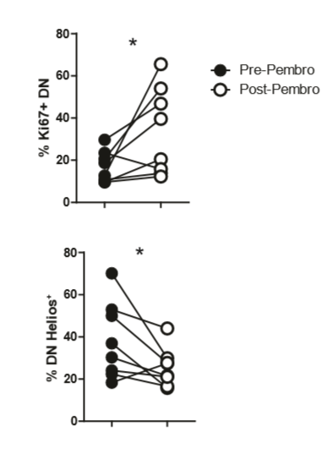

Slide 13
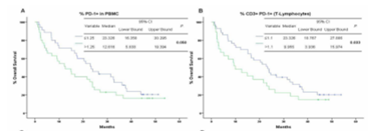
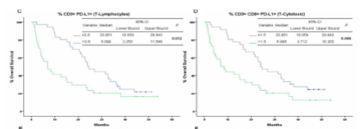
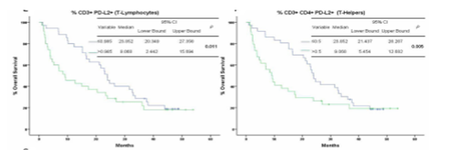
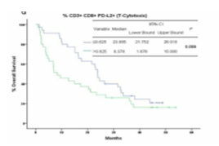

Slide 14
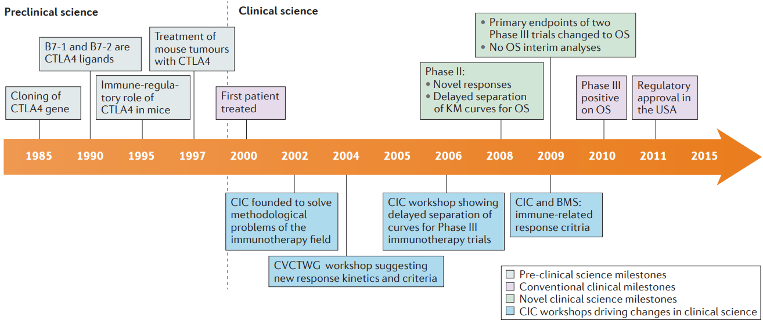
Discovery and development of Ipilimumab (Anti-CTLA4)
Hoos, A. (2016). Development of immuno-oncology drugs — from CTLA4 to PD1 to the next generations. Nature Reviews Drug Discovery, 15, 235.

Slide 15
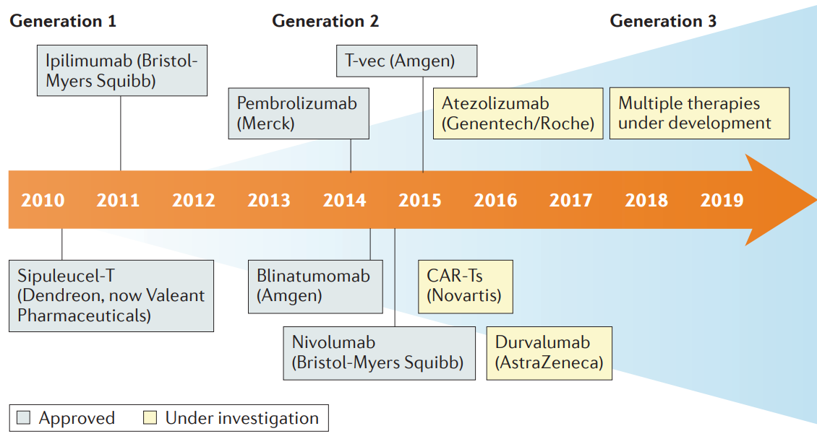
ICIs generations
7
Hoos, A. (2016). Development of immuno-oncology drugs — from CTLA4 to PD1 to the next generations. Nature Reviews Drug Discovery, 15, 235.

Slide 16
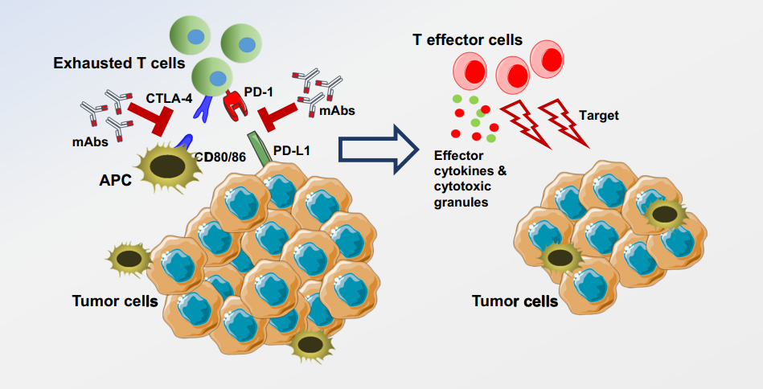
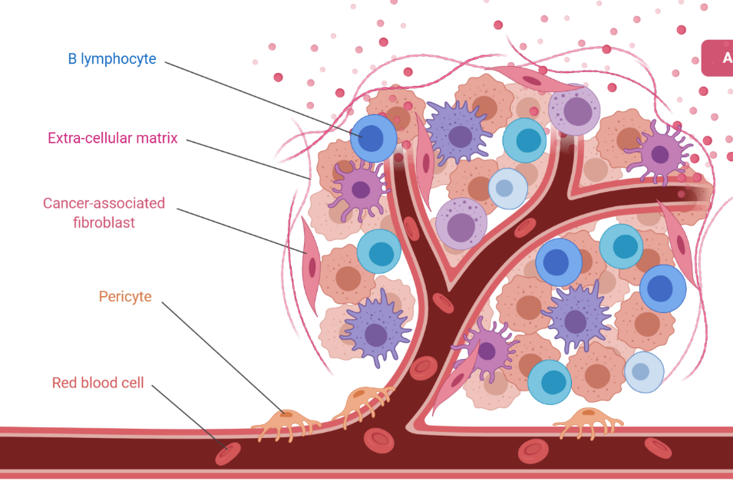
Immune Checkpoint Inhibitors (ICIs) mechanisms
Tumor
Darvin, P., et al(2018). Immune checkpoint inhibitors: recent progress and potential biomarkers. Experimental & molecular medicine, 50(12), 165.

Slide 17
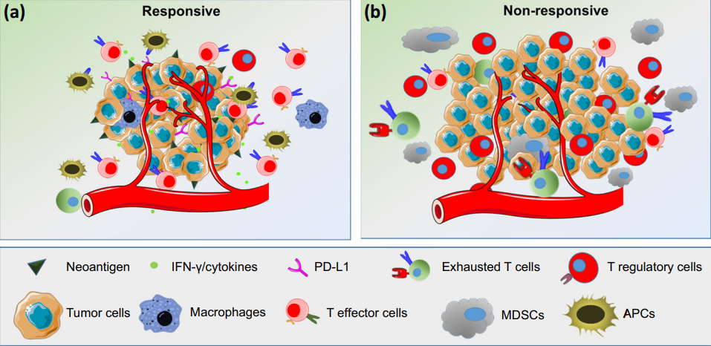
Predicting response to ICIs in Cancer
The response to immune checkpoint inhibitors varies depending on the Tumoral Microenviroment (TME).
General responder tumor characteristics:
Immune cells
High levels of Tumor Infiltrating Lymphocytes, especially effector cells.
High T effector cells and low T regulatory cells ratio.
Low Myeloid Dendritic Stromal Cell infiltrate.
Protein expression
Increased PD-L1 expresion.
Increased secretion of IFN-γ and other stimulatory cytokines.
High neoantigen load.
Gene signatures
Low Tumoral Mutational Burden (TMB)
Overexpression of IGK, GBP1, STAT1, IGLL5, and OCLN5.
Darvin, P., et al(2018). Immune checkpoint inhibitors: recent progress and potential biomarkers. Experimental & molecular medicine, 50(12), 165.

Slide 18
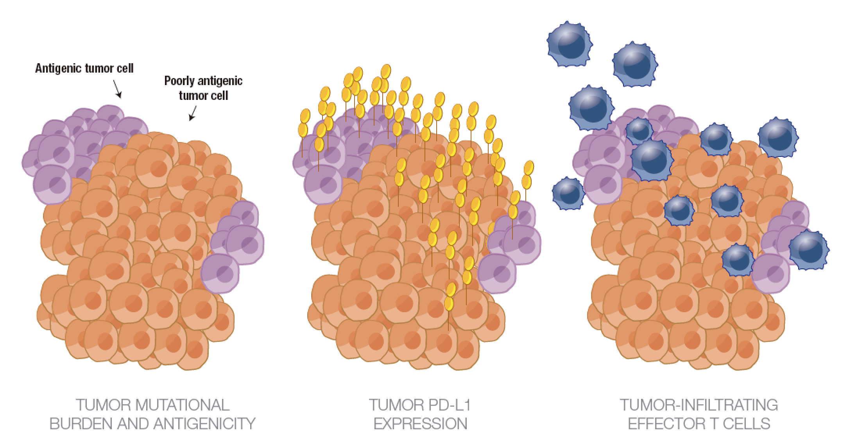
Tumor types differ in their immunogenicity
Tumors that are potentially sensitive to immune-mediated approaches rely on the functional competence of multiple immunological elements, and may be recognized by key traits
TUMOR MUTATIONAL
BURDEN AND ANTIGENICITY
TUMOR PD-L1
EXPRESSION
TUMOR –INFILTRATING
EFFECTOR T CELLS
Beatty GL, Gladney WL. Immune escape mechanisms as a guide for cancer immunotherapy. Clin Cancer Res. 2015;21(4):687-692.
Notes:
Tumor antigenicity represents one such trait, and it is
fundamental to the ability of the immune system to
recognize a tumor and initiate an immune response.41
Tumor antigenicity may be associated with mutational
burden, since the quantity of neoantigens per tumor
correlates with mutational load, which varies from
tumor type and within tumor types.42-44 There is
evidence to suggest that tumor mutational load and
frequency of neoantigen formation may be associated
with sensitivity to immune-mediated approaches.43,45
T-cell infiltration into tumor tissue is also necessary
for successful immune-mediated tumor elimination.41
Tumor PD-L1 expression correlates with the presence
of infiltrating T cells, and potentially with sensitivity to
immune-mediated approaches.41 Moreover, strength of
PD-L1 expression may be associated with sensitivity
to disruption of the PD-1/PD-L1 axis.41,46 PD-L1
expression can vary across and within tumor types,
although some of the variability may be due to the lack
of standardization for determining PD-L1 positivity,
given that there are multiple PD-L1 tests using different
antibodies and different scoring criteria. (Figure 10 on
page 8).47-52
The presence of infiltrating effector T cells may be
indicative of a tumor that has provoked an immune
response, and this has been shown to be prognostic
for several types of cancer.53,54 The presence of high
densities of tumor-infiltrating effector and memory
T cells has also been reported in numerous tumor
types; a more favorable prognosis has been noted
in these tumors.53 Consistent with these findings,
higher density of immune cells may be indicative of
susceptibility to immune-mediated approaches.53
Tumor types differ with regard to their immune
characteristics and, thus, differ in their sensitivity to immune-mediated approaches. Melanoma is considered very sensitive to immune-mediated approaches based on its having one of the highest median frequencies of somatic mutations (Table 1).42,55,56

Slide 19
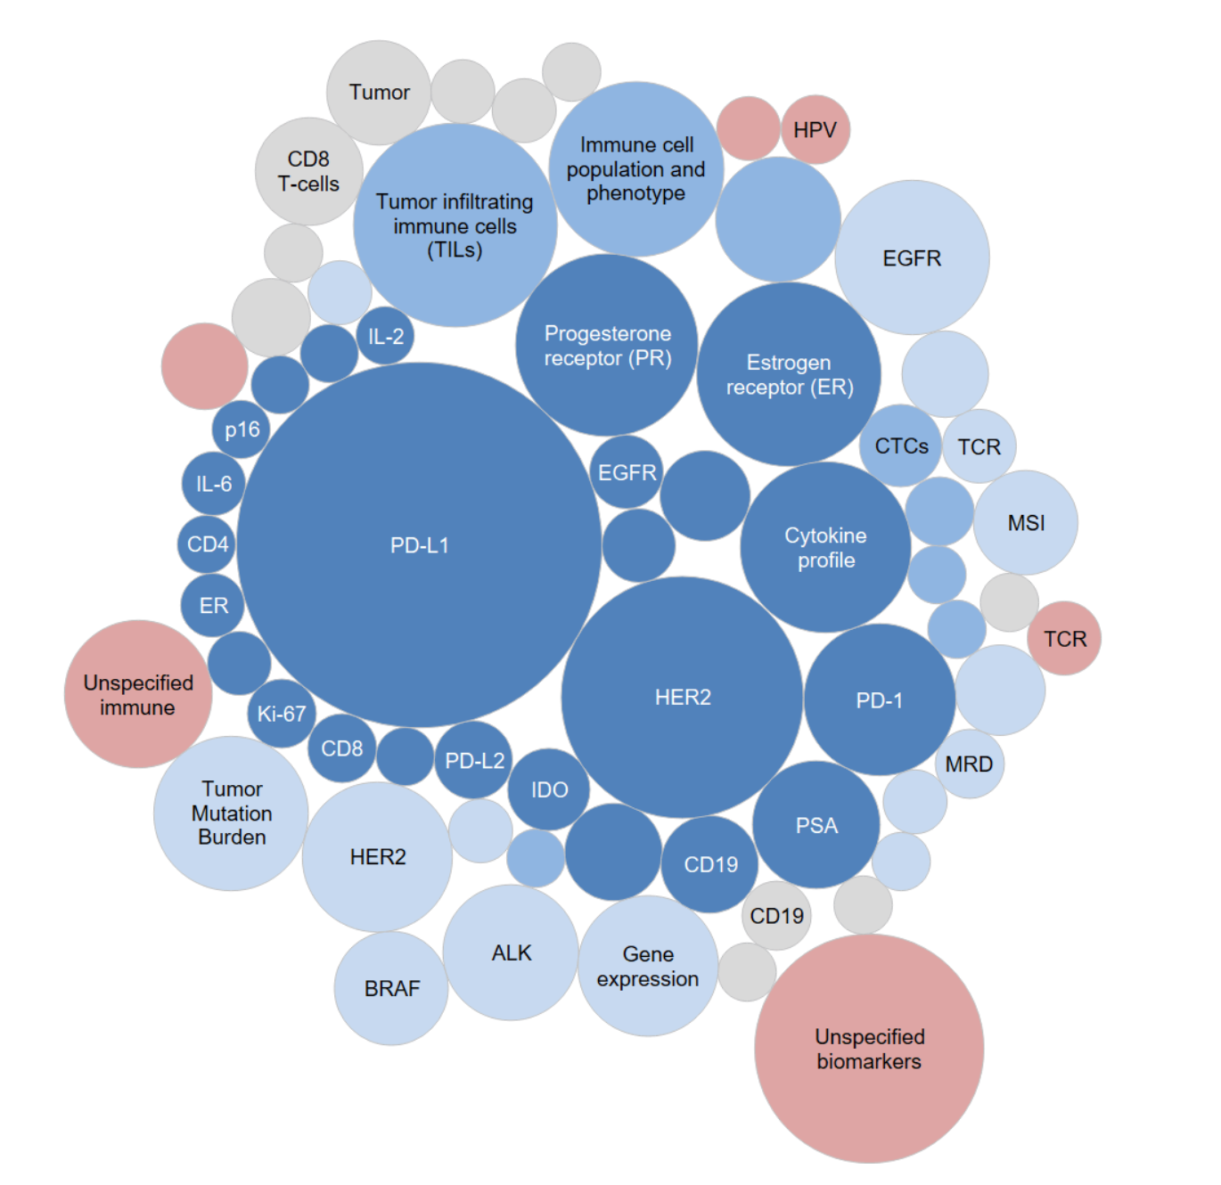
Top Immuno-Oncology Biomarkers studied in clinical trials
The top “novel” immuno-oncology biomarkers identified across 1,100 clinical trials are:
Tumor-infiltrating immune cells
Immune cell populations / phenotypes
Cytokine profiles
Tumor mutation burden / genomic mutation profiling
Gene expression signatures
Source: DeciBio Consulting, LLC. Immuno-Oncology Clinical Trial Biomarker Analysis. Interactive Dashboard. Use with permission. Data retrieved on Apr 16th, 2018.
Notes:
The analysis to-date has captured >2,700 biomarker mentions from >600 different I/O clinical trials. Many of the top biomarkers identified in this analysis (i.e., PD-L1, HER2, ER, PR, EGFR, ALK, BRAF) will not surprise anyone, as testing for these markers has become standard of care for various therapies and indications. However, this analysis reveals many markers on the verge of becoming incorporated into clinical care. The top “novel” immuno-oncology biomarkers identified in this analysis are:
Tumor-infiltrating immune cells (mentioned 70 times in 61 different trials)
Immune cell populations / phenotypes (mentioned 60 times in 45 different trials)
Cytokine profiles (mentioned 52 times in 43 different trials)
Tumor mutation burden / genomic mutation profiling (mentioned 45 times in 35 different trials)
Gene expression signatures (mentioned 33 times in 29 different trials)

Slide 20
What is in the horizon?
Neoantigen
generation
Immune
activation
Immune evasion/suppression
TMB
DNA repair
MSI
Immune stimulation
TCR clonality
Immuno-phenotyping
Checkpoint activation
Immune regulation
Tumour mutational burden
IFNγ gene signature
CD8 and PD-L1 combined analysis

Slide 21
Numerous studies across multiple tumour types show that higher levels of PD-L1 expression enriches for response to anti-PD-1/PD-L1 immunotherapy
Higher ORR in PD-L1 high
Higher ORR in
PD-L1 low/neg
Definition of PD-L1 high
Monotherapies are associated with higher ORRs in patients with
PD-L1 high tumours
Higher responses to combination regimens are observed in patients with tumours expressing
low/no PD-L1
ORR
ORR
NSCLC
Nivolumab (CheckMate 057)
✓
31%
9%
≥1%
Nivolumab + ipilimumab (CheckMate 012)
✓
57–86%
0%
≥1%
Pembrolizumab (KEYNOTE-001)
34–45%
✓
9–17%
≥50%
Pembrolizumab + ipilimumab (KEYNOTE-021)
17%
20–29%
✓
≥50%
Durvalumab (Study 1108: NSCLC cohort)
27%
✓
5%
≥25%
Durvalumab + tremelimumab (Study 006)
22%
29–40%
✓
≥25%
HNSCC
Pembrolizumab (KEYNOTE-055)
17%
✓
8%
≥1%
Pembrolizumab (KEYNOTE-012)
18–21%
✓
6–19%
≥1%
Nivolumab (CheckMate 141)
17–28%
✓
10–12%
≥1%
Durvalumab (Study 1108: HNSCC cohort)
18%
✓
8%
≥25%
UC
Pembrolizumab (KEYNOTE-045: UC cohort)
21.6%
Not available
≥10%
Nivolumab (CheckMate 275)
25%
15%
≥1%
Atezolizumab (Imvigor 210, PCD4989g)
26%
✓
9.5 %
≥5%
Avelumab (JAVELIN)
25%
✓
14%
≥5%
Durvalumab (Study 1108: UC cohort)
26.3%
✓
4.1%
≥25%
Direct comparisons cannot be made between agents due to different trial designs, patient populations, treatment line, PD-L1 assays and PD-L1 expression cut-off used
NSCLC, non-small cell lung cancer; HNSCC, head and neck squamous cell carcinoma; UC, urothelial carcinoma
References are provided in the slide notes
ORR= Objective Response Rate
Notes:
ORR= Objective Response Rate
NSCLC
Checkmate 057 (Phase III; vs. docetaxel): Borghaei H, et al. N Engl J Med 2015;373:1627–39 (supplementary appendix)
Checkmate 012 (Phase I): Hellmann et al. Oral presentation at ASCO 2016 (Abstract 3001)
KEYNOTE-001 (Phase I): Garon EB, et al. N Engl J Med 2015;372:2018–28
Keynote-021 (Phase I/II): Gubens MA, et al. Poster presented at ASCO 2016 (Abstract 9027)
Study 1108 (Phase I/II; preliminary data): NSCLC - Rizvi N, et al. Poster presented at ASCO 2015 (Abstract 8032)
Study 006 (Phase Ib): Antonia S, et al. Lancet Oncol 2016.;17:299–308
HNSCC
KEYNOTE-055 (Phase II): Baumi J, et al. Oral presentation at ASCO 2016 (Abstract 6011)
KEYNOTE-012: Chow LQ, et al. Oral presentation at ASCO 2016 (Abstract 6010)
Checkmate 141: Ferris R, et al. Oral presentation at ASCO 2016 (Abstract 6009)
Study 1108 (Phase I/II; preliminary data): HNSCC - Segal NH, et al. Poster presented at ASCO 2015 (Abstract 3011)
UC
Keynote 012: Plimack ER, et al. Oral presentation at ASCO 2015 (Abstract 4502)
CheckMate 032: Sharma P, et al. Oral presented at ASCO 2016 (Abstract 4501)
Imvigor 210 (Phase I): Rosenberg JE, et al. Lancet 2016;387:1909–20; PCD4989g (Phase I): Powles T, et al. Nature 2014;515:558–63.
JAVELIN (Phase Ib): Apolo AB, et al. Poster presented at ASCO 2016 (Abstract 4514).
Study 1108 (Phase I/II; preliminary data): UC -Massard C, et al. J Clin Oncol. 2016;pii:JCO679761. [Epub ahead of print].

Slide 22
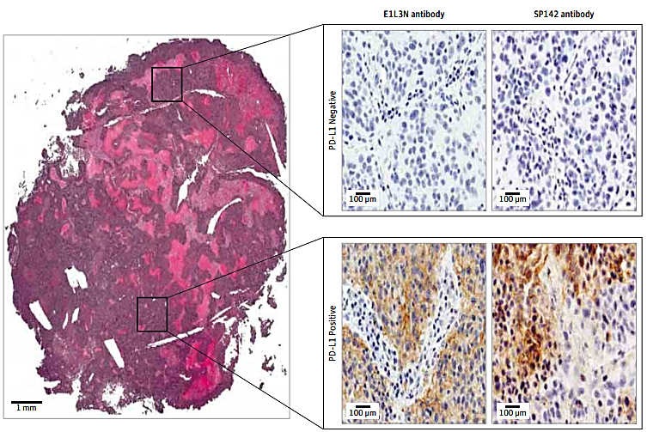
Quantitative assessment of the heterogeneity of PD-L1 expression in Non–Small-Cell Lung Cancer
McLaughlin J, et al. JAMA Oncol. doi:10.1001/jamaoncol.2015.3638

Slide 23
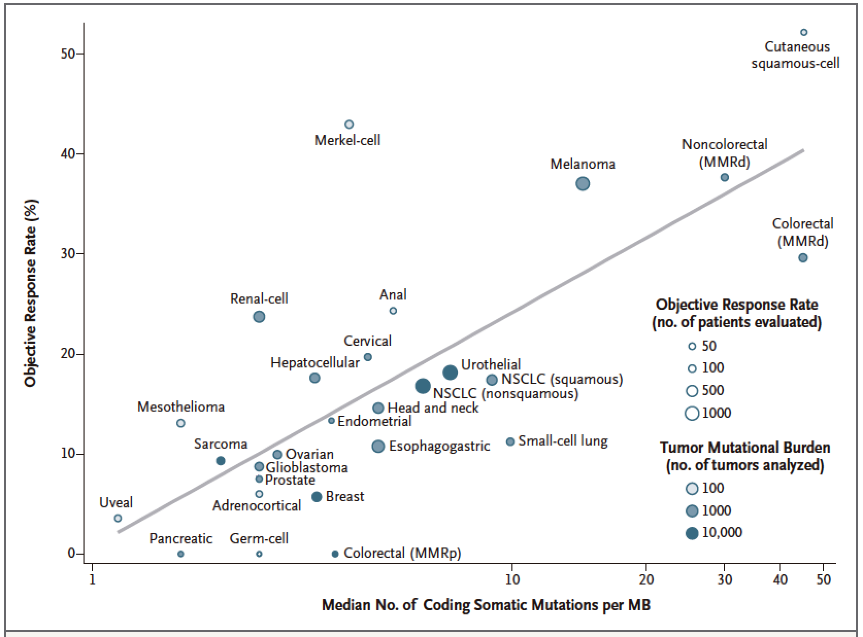






Tumors with higher mutation burden are more immunogenic; therefore more sensitive to IO
Increased TMB
Increased neo-antigen load
Time
Normal cell
Cancer cell
Increased TMB
T-cell activation
_{G R} Y
_{G R} Y
T-cell
G
A
A
Red = immunogenic mutation
Black = non-immunogenic mutation
Champiat et al., Oncoimmunology 2014 Yarchoan et al., NEJM 2017
Notes:
Figure 1. Correlation between Tumor Mutational Burden and Objective Response Rate with Anti–PD-1 or Anti–PDL1 Therapy in 27 Tumor Types.
Shown is the median number of coding somatic mutations per megabase (MB) of DNA in 27 tumor types or subtypes among patients who received inhibitors of programmed death 1 (PD-1) protein or its ligand (PD-L1), as described in published studies for which data regarding the objective response rate are available. The number of patients who were evaluated for the objective response rate is shown for each tumor type (size of the circle), along with the number of tumor samples that were analyzed to calculate the tumor mutational burden (degree of shading of the circle). Data on the x axis are shown on a logarithmic scale. MMRd denotes mismatch repair-deficient, MMRp mismatch repair-proficient, and NSCLC non–small-cell lung cancer.

Slide 24
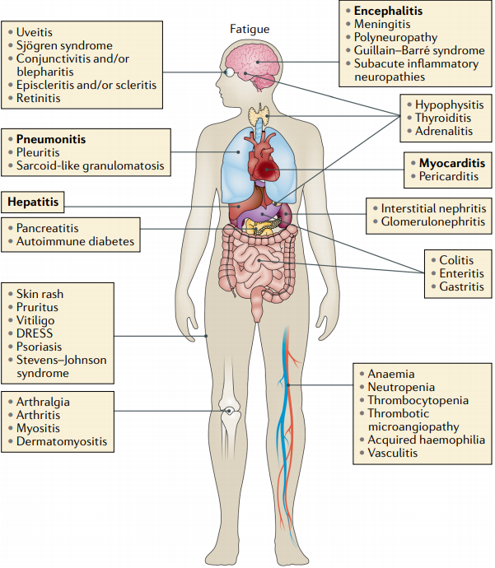
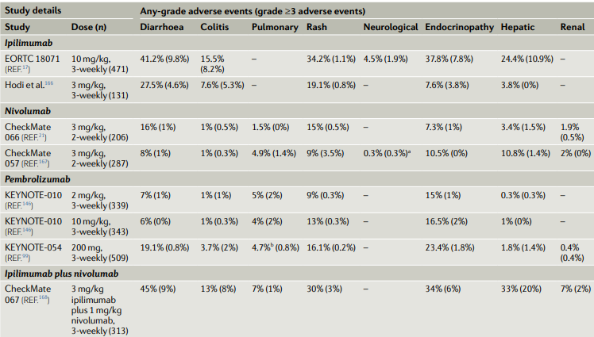
Immune related adverse events (irAEs) associated to the administration of ICIs
irAEs spectrum by affected organ
Frequency of irAEs in ICIs clinical trials
Martins, F., et al (2019). Adverse effects of immune-checkpoint inhibitors: epidemiology, management and surveillance. Nature Reviews Clinical Oncology, 16(9), 563–580

Slide 25
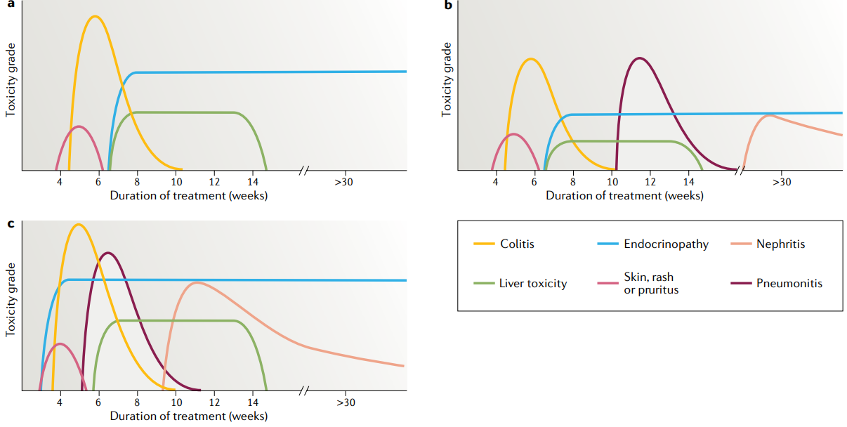
Immune related adverse events (irAEs) kinetics
Anti- PD1
Anti- PD-L1
Anti- PD-1 + Anti CTLA4
Martins, F., et al (2019). Adverse effects of immune-checkpoint inhibitors: epidemiology, management and surveillance. Nature Reviews Clinical Oncology, 16(9), 563–580

Slide 26
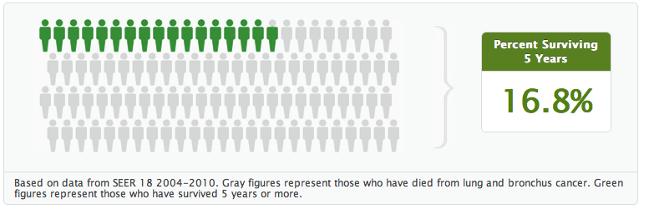
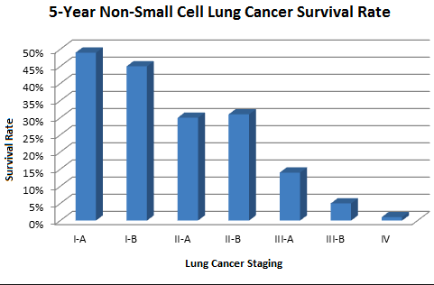
NSCLC 5 year survival rate
SEER cancer statistics

Slide 27
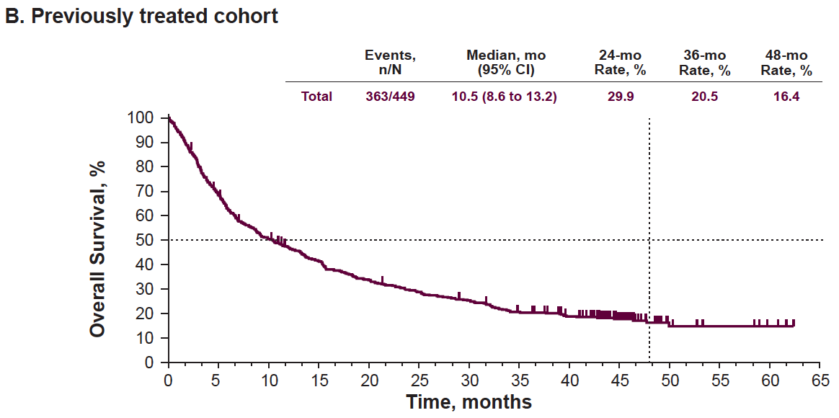
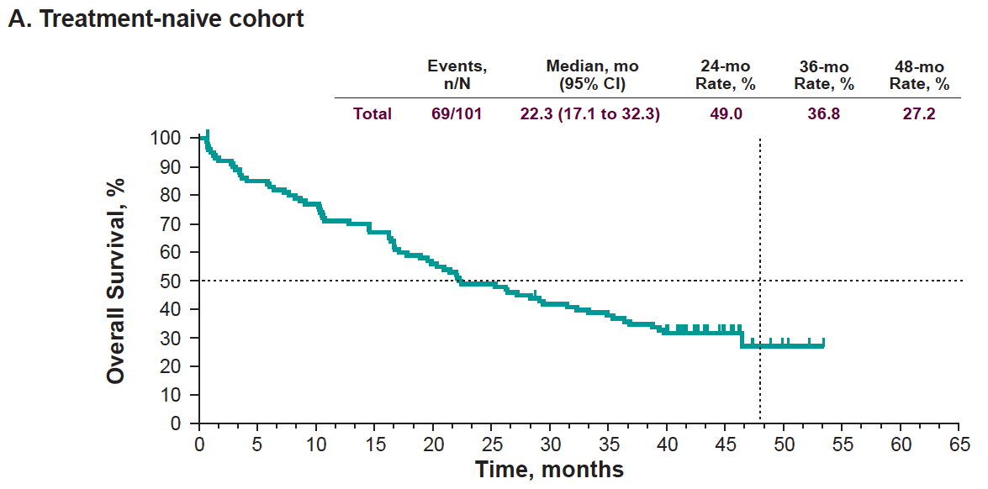
Is ICI a real revolution in NSCLC?
4-years OS in 8th TNM Classification for M1c: 0%
KEYNOTE 001, 4-y OS
Felip – ASCO 2018 * Eberhardt – J Thorac Oncol 2015

Slide 28
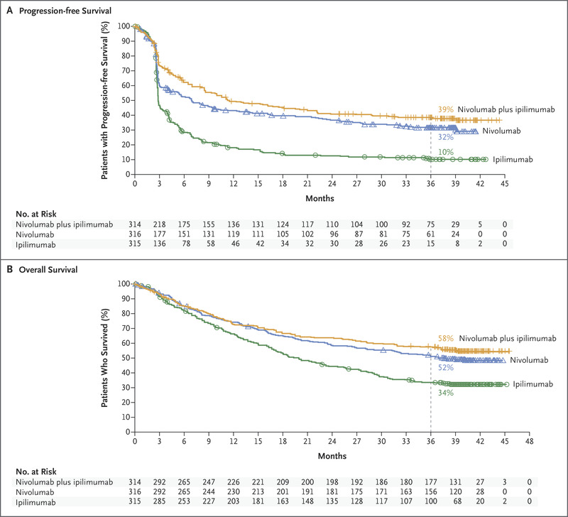
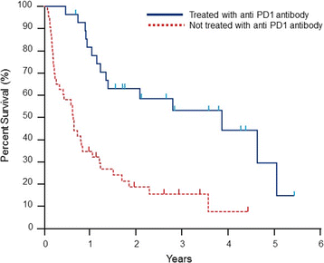
Melanoma

Slide 29
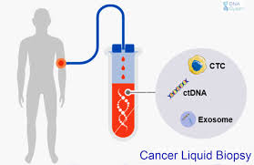
Future challenges for Immunotherapy in NSCLC
Low accessibility of ICIs in world developing countries.
Identification of tumor antigens.
Evaluate novel Immunotherapy combinations.
Explore novel predictive biomarkers strategies to determine a good IT response, such as liquid biopsy for circulating tumor cells (CTC), circulating tumor DNA (ctDNA) and tumor-derived exosome determination.
Determine specific tumor resistance mechanisms against IT.

Slide 30
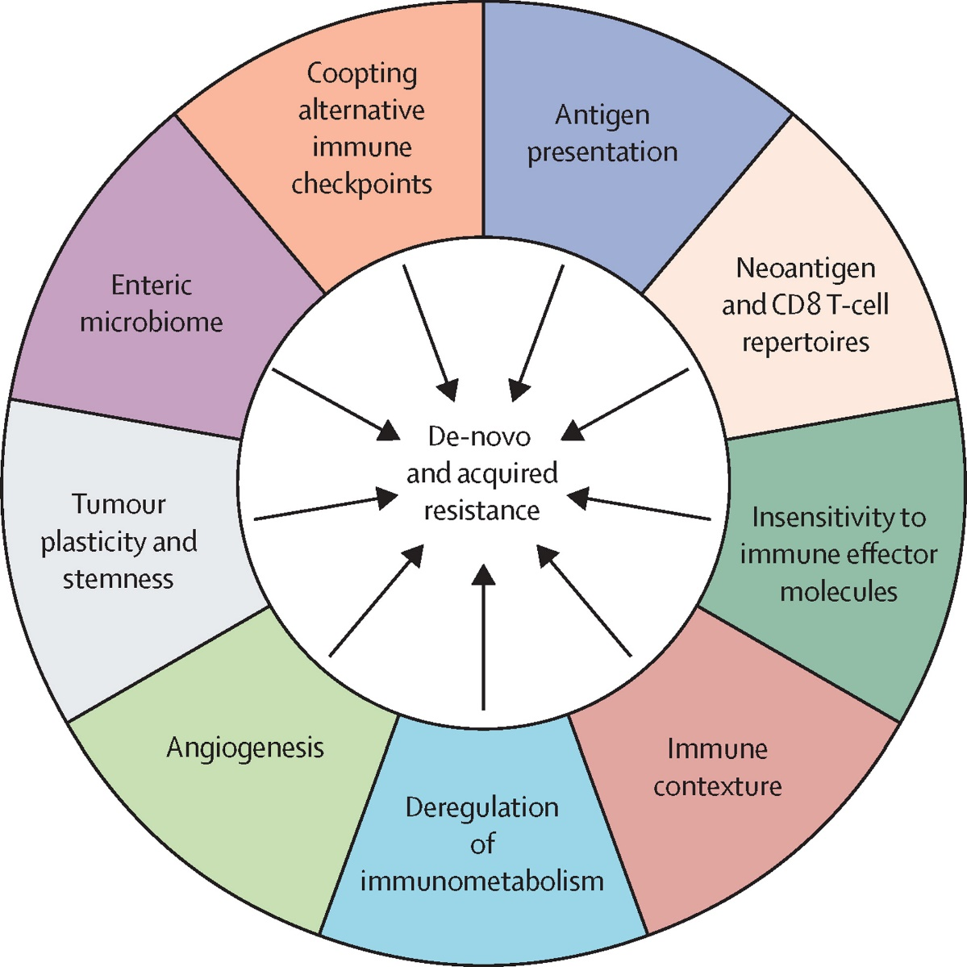
Microbiome
Primary resistance, observed in 60 to 70% of cases, has been attributed to
low mutational burden,
poor intrinsic antigenicity of tumor cells,
absence of priming by potentially immunogenic pretreatment with chemo- or radiotherapy,
defective antigen presentation during the priming phase,
local immunosuppression by extracellular metabolites,
functional exhaustion of tumor-infiltrating lymphocytes

Slide 31
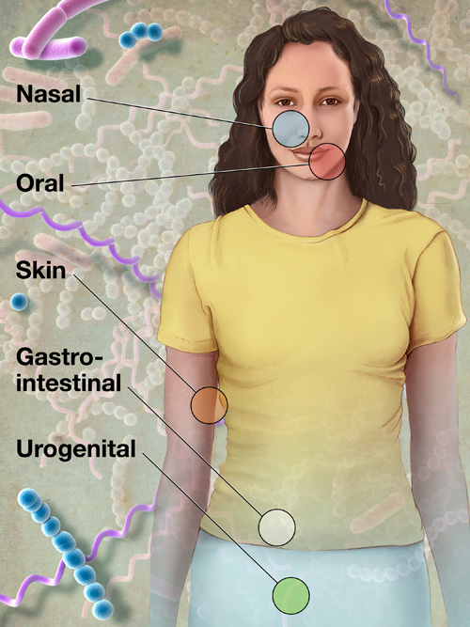
Microbiome –
Another piece of the puzzle
What is the Microbiome?
Microbe (bacteria, fungi, viruses, protozoa)
(Human body= >10⁴ microbial cells, greater than all somatic and germ cells in the body)
A population of micro-organisms present in a particular biological niche= microbiota¹
The collective genomes of the microbiota= microbiome
Known to influence health and disease
Distinct microbiota in the human body
Nasal, Oral, Skin, GI, Urogenital
‘Gut’ microbiome is the most populous
Bultman et al, Carcinogenesis 2014
Notes:
What exactly is the microbiome

Slide 32
Biological importance of A. muciniphila during anticancer PD-1 blockade treatment.

Slide 33
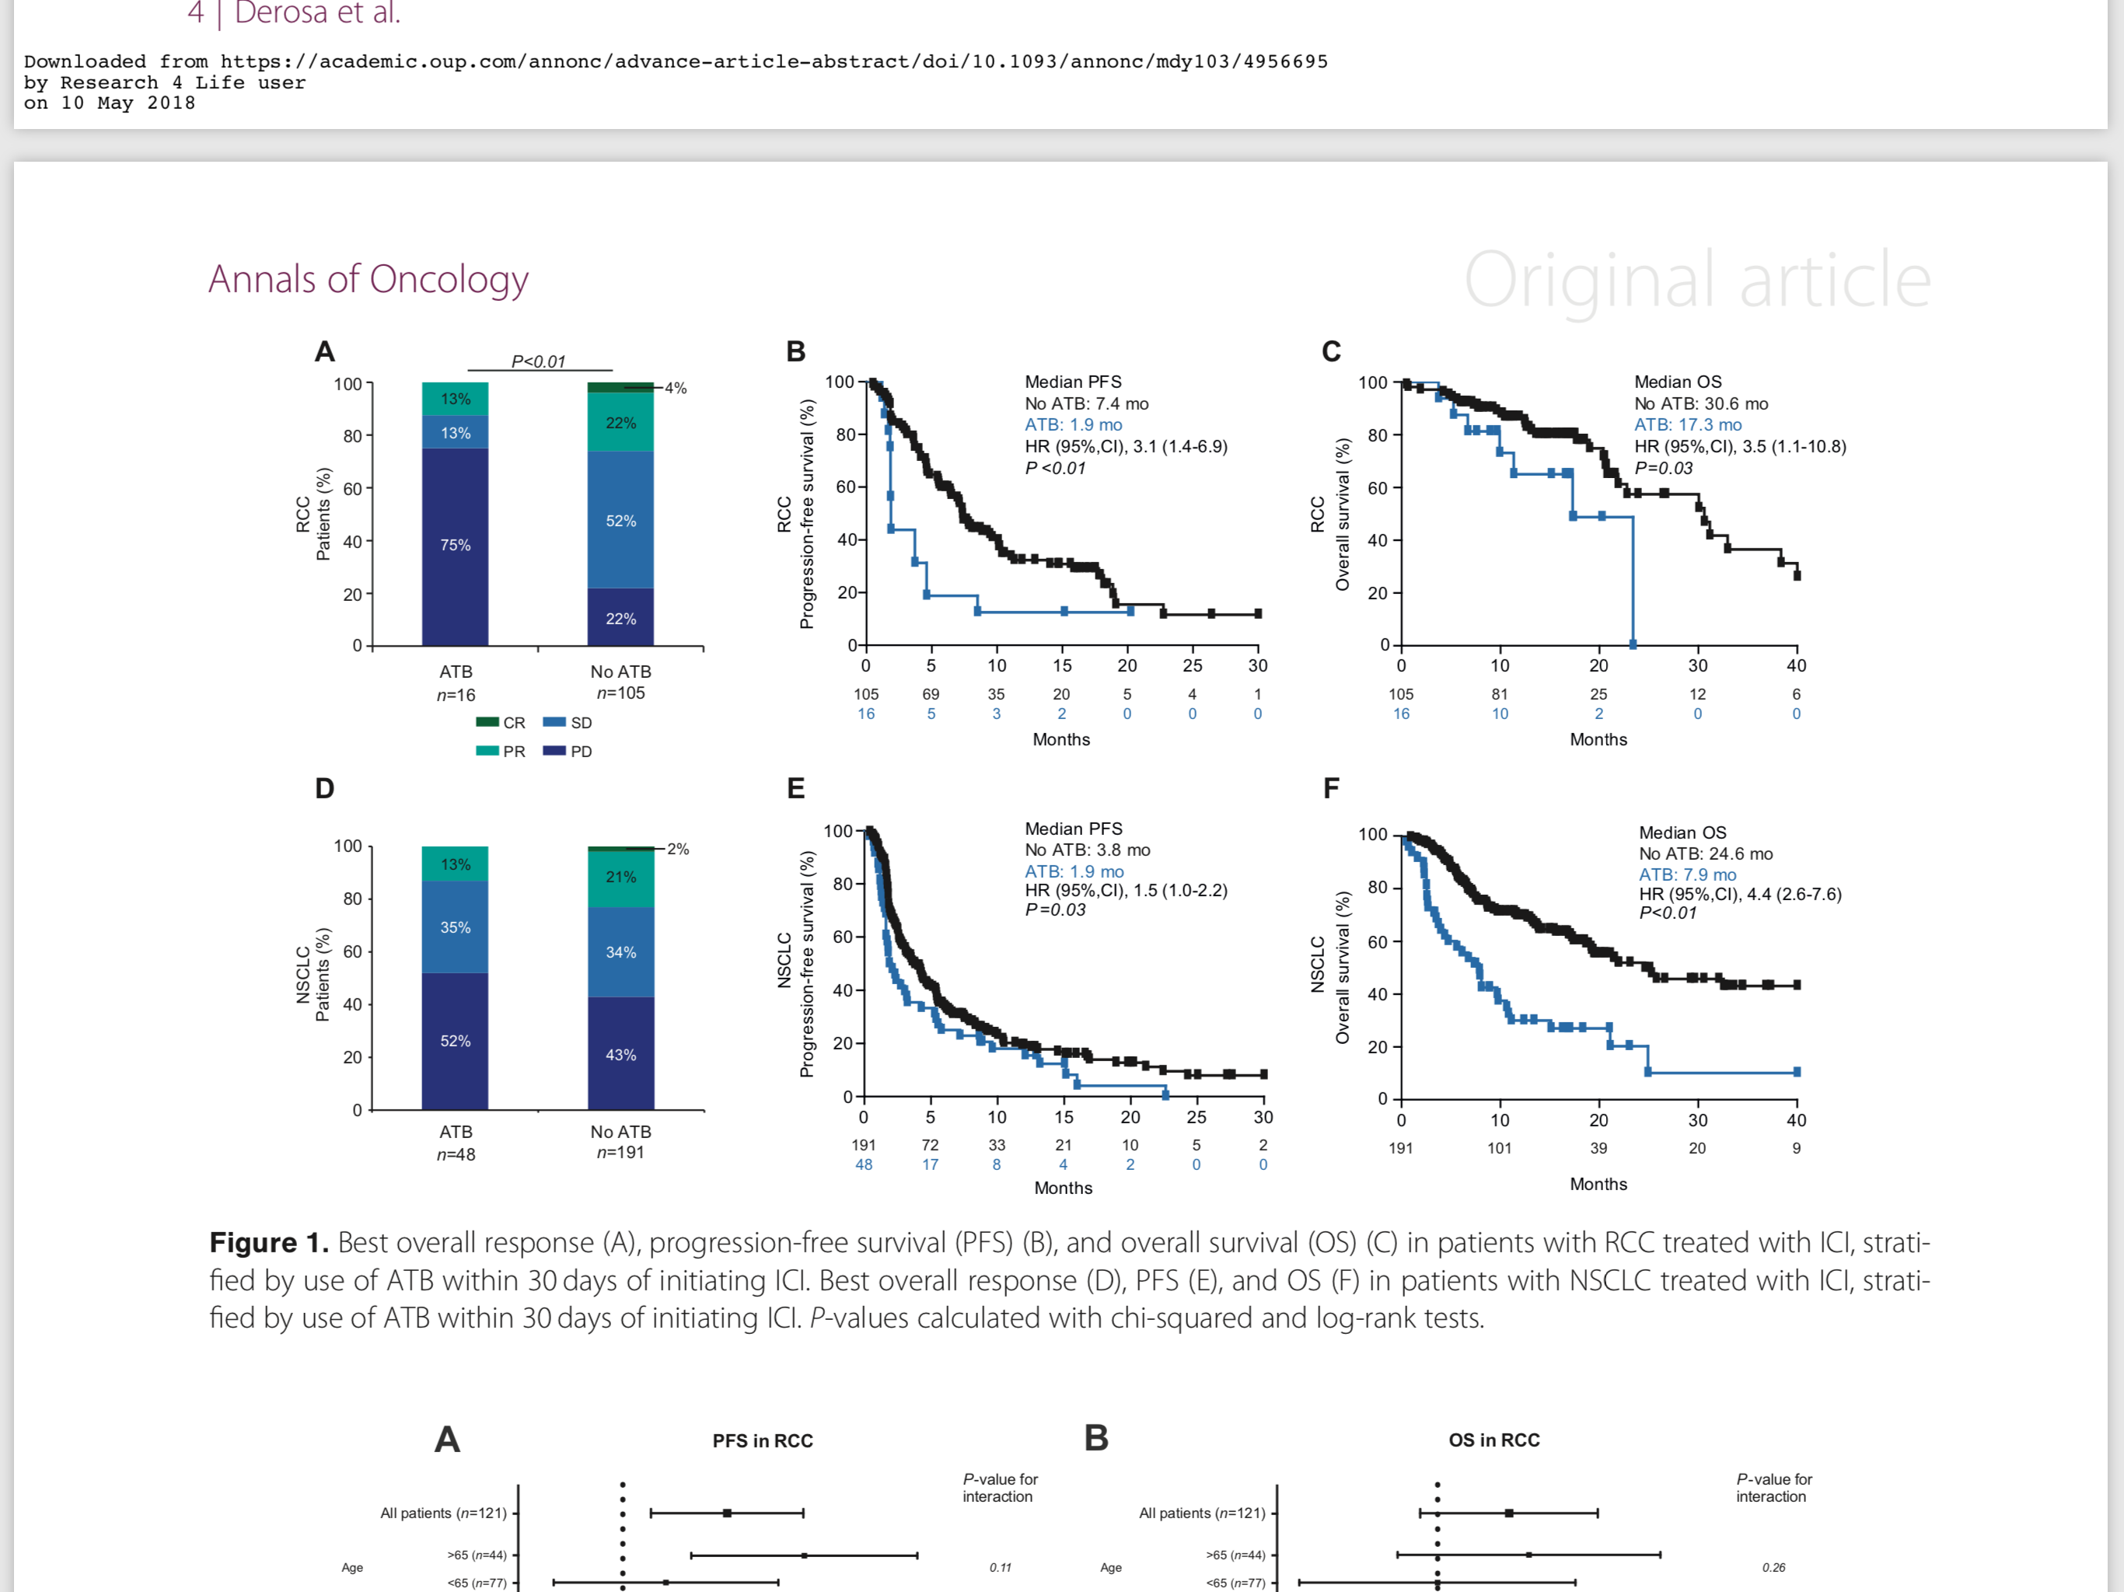
PFS and OS
Median PFS, 1.9 months versus 3.8 months, HR 1.5, 95% CI 1.0–2.2, P = 0.03
Median OS, 7.9 months versus 24.6 months, HR 4.4, 95% CI 2.6–7.7, P < 0.01

Slide 34
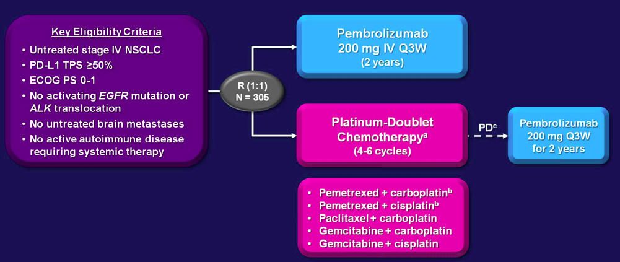
PD-L1 ≥ 50% is predictive: KEYNOTE 024
1934 screened
1729 samples
For PD-L1
1653 samples
evaluated
54% crossover
Primary endpoint: PFS
(Squamous ~19%, BM ~10%)
500 PDL1 ≥50%
(30%)
PFS: 10.3 vs. 6.0, HR: 0.50 (p<0.001) * RR: 45% vs. 18% * OS: HR 0.60, p=0.005
305 Random
(16% of 1st step)
Updated results PFS (Fw 19.2 mo, crossover 60%): 18.3 vs. 8.4, HR 0.54 (p<0.001)
Reck – NEJM 2016 * Brahmer – ASCO 2017

Slide 35
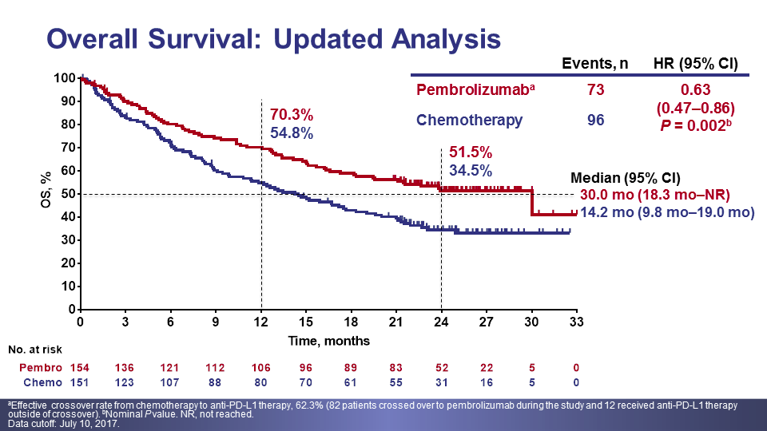
PD-L1 ≥ 50% is predictive: KEYNOTE 024
OS
(Fw: 25.2 mo.)
54% crossover
PFS (Fw: 19.1 mo.)
OS
Not selected patients
If PD-L1≥ 50%, Pembrolizumab
better 1st than 2nd line
QoL
Reck – NEJM 2016 * Brahmer – ASCO 2017 * Brahmer – WCLC 2017 * Brahmer – Lancet Oncol 2017

Slide 36
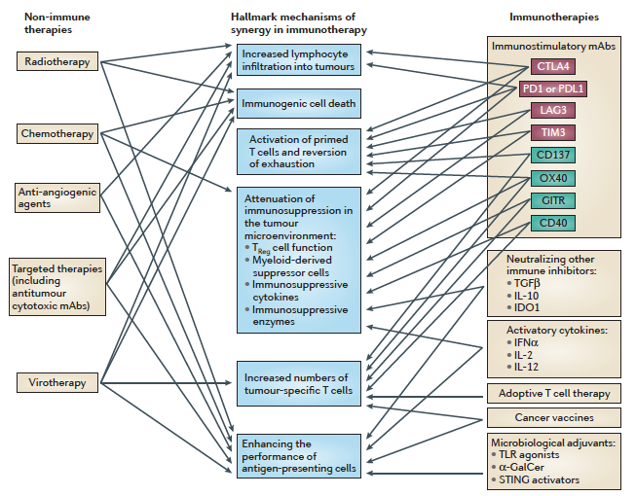
Synergistic strategies with ICI
Melero – Nat Rev Cancer 2015

Slide 37
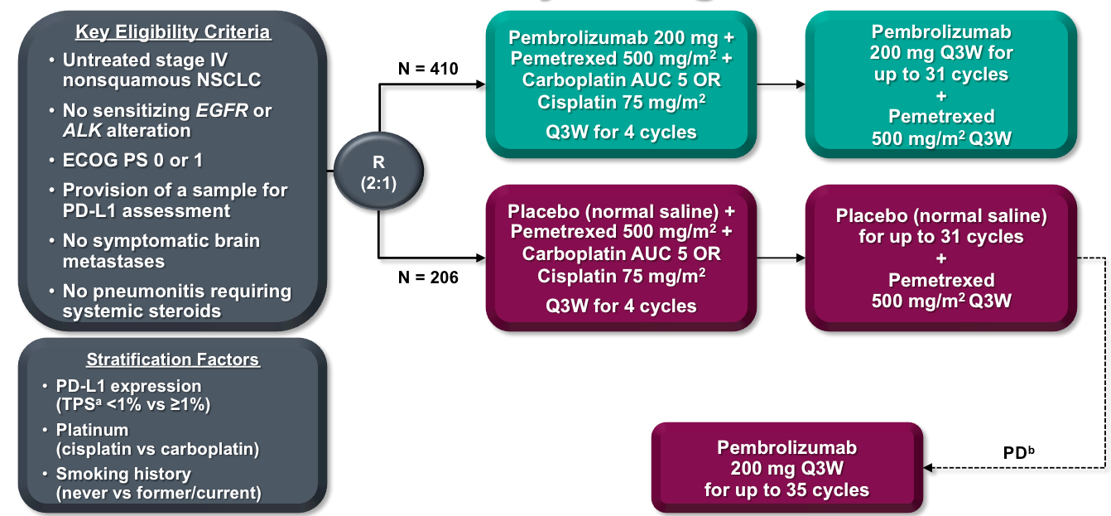
KEYNOTE 189
17% stable BM
~30% PD-L1 ≥ 50%
~70% CBDCA
~88% smokers
41.3% Crossover
Primary endpoint: OS / PFS
Gandhi – NEJM 2018

Slide 38
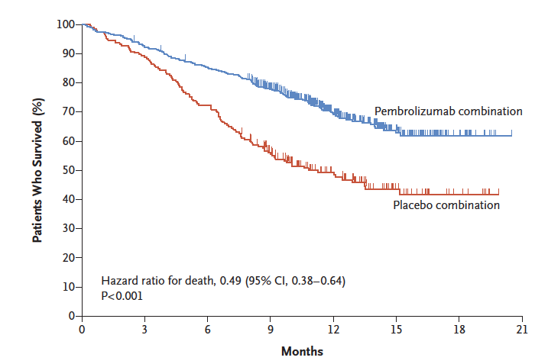
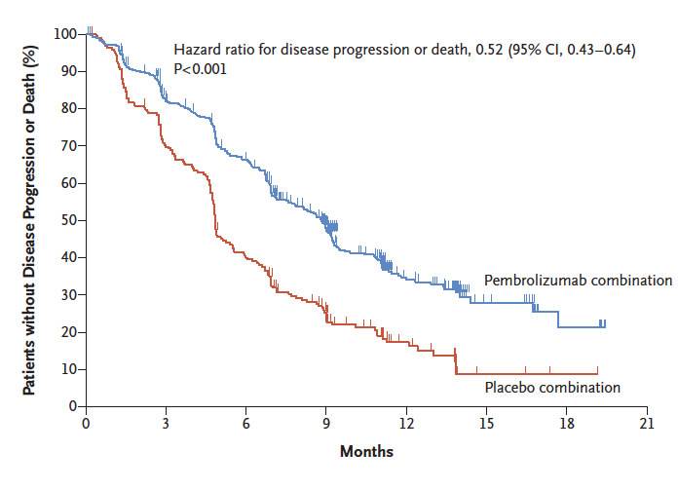
KEYNOTE 189
OS
NR vs. 11.3 mo., HR: 0.49
PFS
8.8 vs. 4.9 mo., HR: 0.52
RR: 47.6% vs. 18.9%, p<0.001
FDA Approved Aug 17th, 2018
Gandhi – NEJM 2018

Slide 39

Pembrolizumab plus Docetaxel versus Docetaxel as second-line treatment for patients with advanced non-small cell lung cancer: A randomized, phase II trial.
Presented by:
Dr. Oscar Gerardo Arrieta Rodríguez
Head of Thoracic Oncology Unit
Instituto Nacional de Cancerología - Mexico

Slide 40

Therapeutic response
 | Pembrolizumab + Docetaxel | Docetaxel
Objective Response Rate (ORR) | n=40 | n=38 | p-Value
No. of patients | 21 | 11
% (95% CI) | 52.5% (36.6% - 68.4%) | 28.9% (14.1% - 43.8%) | 0.035
Tumoral best response
Complete response, % (n) | 0 (0) | 0 (0)
Partial response, % (n) | 55.0 (22) | 28.9 (11)
Stable disease, % (n) | 30.0 (12) | 31.6 (12)
Disease Progression, % (n) | 15.0 (6) | 39.5 (15) | 0.024
Odd Ratio, 95% CI:2.7 (1.06 - 6.91)

Slide 41
Factors associated with PFS
 | No. (Events) | Median (95% CI), months | p-value
Overall | 78 (38) | 6.5 (4.9 - 8.1)
Sex
Female | 46 (22) | 6.8 (5.2 - 8.4)
Male | 32 (16) | 5.9 (0.0 - 16.3) | 0.253
Age
<60 yrs | 36 (22) | 5.9 (3.6 - 8.2)
60+ | 42 (16) | 6.8 (0.0 - 17.5) | 0.253
Tobacco exposure
Never smokers | 34 (17) | 6.9 2.9 - 10.7)
Ever smokers | 44 (21) | 6.4 (5.0 - 7.9) | 0.751
WSE
Absent | 58 (27) | 6.8 (4.5 - 8.9)
Present | 20 (11) | 5.3 (3.4 - 7.1) | 0.271
Disease stage at diagnosis*
III | 13 (2) | NR (NR)
IV | 65 (36) | 5.3 (3.4 - 7.1) | 0.042
Histology
Adenocarcinoma | 70 (34) | 6.8 (4.1 - 9.4)
Other | 8 (4) | 3.6 (1.5 - 5.8) | 0.289
Adenocarcinoma hystological subtype
Well/Moderate differentiated | 33 (14) | 6.4 (4.2 - 8.7)
Poorly differrentiated | 25 (14) | 6.9 (3.3 - 10.5)
Not specified | 12 (6) | 6.5 (0.0 - 13.4) | 0.906
EGFR status
wild-type | 54 (27) | 6.8 (3.1 - 10.5)
EGFR (+) | 24 (11) | 5.9 (1.6 - 10.2) | 0.29
Carcinoembrionic antigen
<15 pg/mL | 43 (17) | 8.3 (4.9 - 11.6)
15+ pg/mL | 35 (21) | 5.9 (2.5 - 9.4) | 0.101
PD-L1 expression
Absent | 59 (29) | 6.4 (4.5 - 8.4)
Present | 19 (9) | 6.5 (0.0 - 14.6) | 0.546
Therapeutic arm
Pembrolizumab + Docetaxel | 40 (16) | 16.0 (5.9 - 26.0)
Docetaxel | 38 (22) | 4.1 (2.4 - 5.8) | 0.001

Slide 42
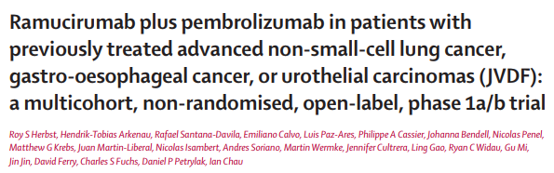
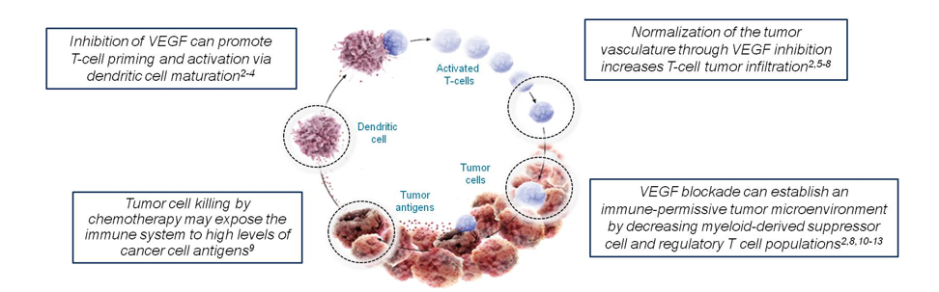
  Rationale for the combination of immunotherapy + antiangiogenic therapy
In addition to its known anti-angiogenic effects, ramucirumab’s inhibition has immune modulatory effects
Pembrolizumab T cell mediated cancer cell killing may be enhanced through ramucirumab’s reversal of VEGF-mediated inmunosuppresion.

Slide 43
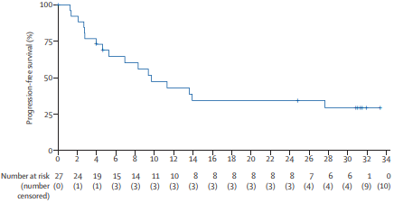
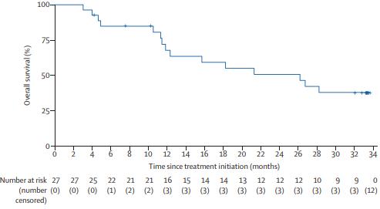
Ramucirumab plus pembrolizumab
Anti-Angiogenesis plus inmunotherapy
Progression free survival
9.7 months (95% IC 4.6-27.6 m)
Overall survival
26.2 months (95% IC 11.8-NR)
Median duration of treatment in NSCLC patients was 7 months with ramucirumab (3.0-16.8 m) and 8.3 months with pembrolizumab (3.3-23.7 m)

Slide 44
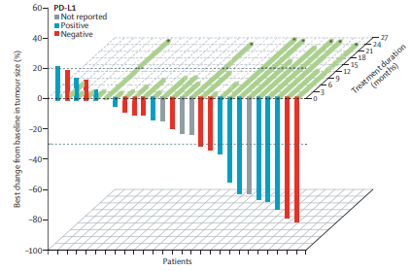
  Best change from baseline in tumour size of NSCLC patients
The combination of ramucirumab with pembrolizumab appears to have a manageable safety profile and efective clinical activity in NSCLC compared to other solid tumours.
The combination of ramucirumab with pembrolizumab should be explored in future trials either with or without chemotherapy in NSCLC patients

Slide 45
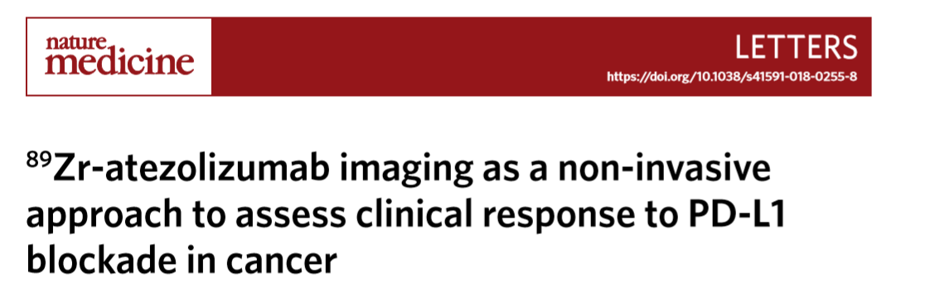


Biodistribución:
  Captación baja: cerebro sano, Tej. Subcutaneo, musculo, hueso compacto y pulmón
  Captación mayor: intestino, riñón e hígado
  En MO aumentó con el tiempo
  Absorción bazo→ unión especifica al objetivo
Nat Med. 2018 Dec;24(12):1852-1858.
Notes:
Pegar imagen del articulo 1ª
Mayor: reflejan pble metabolismo y eliminaiocn del Ac
EN MO se considero especifica, no por acumuacion de radiotrazador libre
PD-L1 IHC mostró expresión variable en ganglios linfáticos no malignos y expresión prominente en el bazo, coincidiendo esta última con la expresión de CD8

Slide 46




Sitios de metástasis 7 días posterior a aplicación 89Zr-atezolizumab
Nat Med. 2018 Dec;24(12):1852-1858.
GL no malignos con IHQ PDL1, con captación heterogénea de PDL1
¿SNC?
Nat Med. 2018 Dec;24(12):1852-1858.
Tej. Bazo sano con alta tincion de PDL1 y CD8
Captación en tejido sano posterior a los 7 días de inyección
Notes:
Imagen 2
2e. imágenes de PET / TC de lesiones de tres pacientes con captación de 89Zr-atezolizumab intralesional heterogénea en el día 7 después de la inyección (tomografías PET se realizaron una vez por paciente y punto temporal). Lesión mediastínica de un paciente con CPNM (SUVmax 19.9) (izquierda), metástasis en la pared abdominal de una vejiga paciente con cáncer (SUVmax 36.4) (medio), y metástasis ósea de un paciente con TNBC (SUVmax 7.1) (derecha).
Debido a que los pacientes con metástasis en el sistema nervioso central se excluyeron del estudio, se desconoce si estas metástasis también podrían visualizarse

Slide 47


89Zr-atezolizumab como predictor de respuesta
La captación de 89Zr-atezolizumab aumentó con mejor categoría de respuesta tumoral y se relaciono con el cambio del tamaño de la lesión.
RC tuvo SUVmax 235% mas alto que los px con PE (IC 95%, p:0.00021)
Nat Med. 2018 Dec;24(12):1852-1858.
Notes:
las áreas del gráfico de violín gris muestran la distribución real de SUVmax en el nivel de metástasis por la mejor categoría de respuesta RECIST, con valores de 1% inferior y superior truncados (primero, quincuagésimo, y noventa y noveno SUVmax percentil: 3.5, 5.9, 14.7 para PD; 1.8, 90, 18.7 para SD; 3.5, 13.5, 36.0 para PR; 8.3, 23.2, 43.2 para CR); los puntos muestran la captación media geométrica por paciente, con colores que indican el tipo de tumor (rojo, TNBC; azul, NSCLC; amarillo, cáncer de vejiga);
un doble aumento en la media geométrica SUVmax por paciente fue asociado con un mejor cambio en el tamaño de la lesión objetivo desde la línea de base de −35% en promedio (IC del 95%: −61 a −9%; P = 0.010). Además,

Slide 48
89Zr-atezolizumab como predictor de respuesta
Aquellos por debajo de la mediana geométrica SUVmax era probable que progresara o falleciera vs con captación superior
Mayor expresión de PD-L1 por IHQ no se relacionó con un mejor resultado
Notes:
La media geométrica SUVmax por paciente estaba fuertemente relacionada con PFS (14 eventos) y supervivencia general (OS; 11 eventos): aquellos con la absorción por debajo de la mediana era más probable que progresara o muriera que aquellos con captación superior a la mediana (fig. 4c). Estas relaciones entre la captación de 89Zr-atezolizumab y el resultado del paciente no cambiaron y se mantuvo significativo después del ajuste por tipo de tumor y carga tumoral (tabla complementaria 4) y cuando se analiza de forma continua

Slide 49


Slide 50


Slide 51
Immuno oncology evolution
Lon
3rd Generation
2nd Generation
C5F1Rinh
1st Generation
OX40
IDO
CD40 agonists
LAG3
CTLA-4
Triple combos
CTLA-4
TIM3
TIM3
CTLA-4
PD1/PDL1
PDL1
PD1/PDL1
Combos
LAG3
PD1
OX40
2016
2020
2025
Long term disease control
Long term impact in OS
Cure
IMS health evolution.org

