Slide 1
Nuevas Moléculas
¿Existen?
¿Serán eficaces?

Slide 2
Adrián Camacho-Ortiz
Coordinador de Epidemiología Hospitalaria,
Profesor del Servicio de Infectología
Hospital Universitario “Dr. José Eleuterio González”
acamacho_md@yahoo.com

Slide 3
Conflictos de interés
Speaker
Merk Sharp Dome
Stendhal
Pfizer
Bayer
Aztra Zeneca

Slide 4
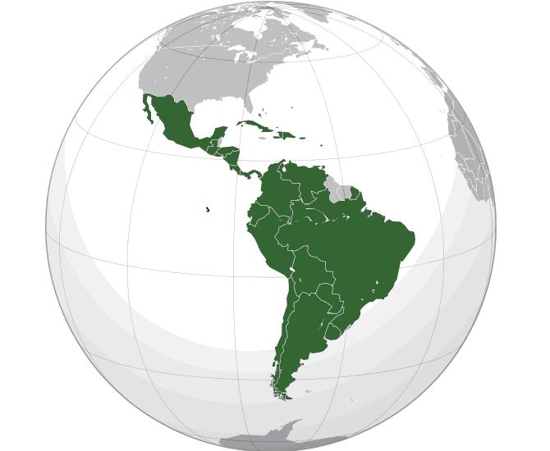
A grandes rasgos …
30-40% BLEE
75% C difficile NAP1 (like)
~50%
P aeruginosa MDR
10% VRE
50-60% MRSA
90%
A baumannii MDR
Impresión personal

Slide 5
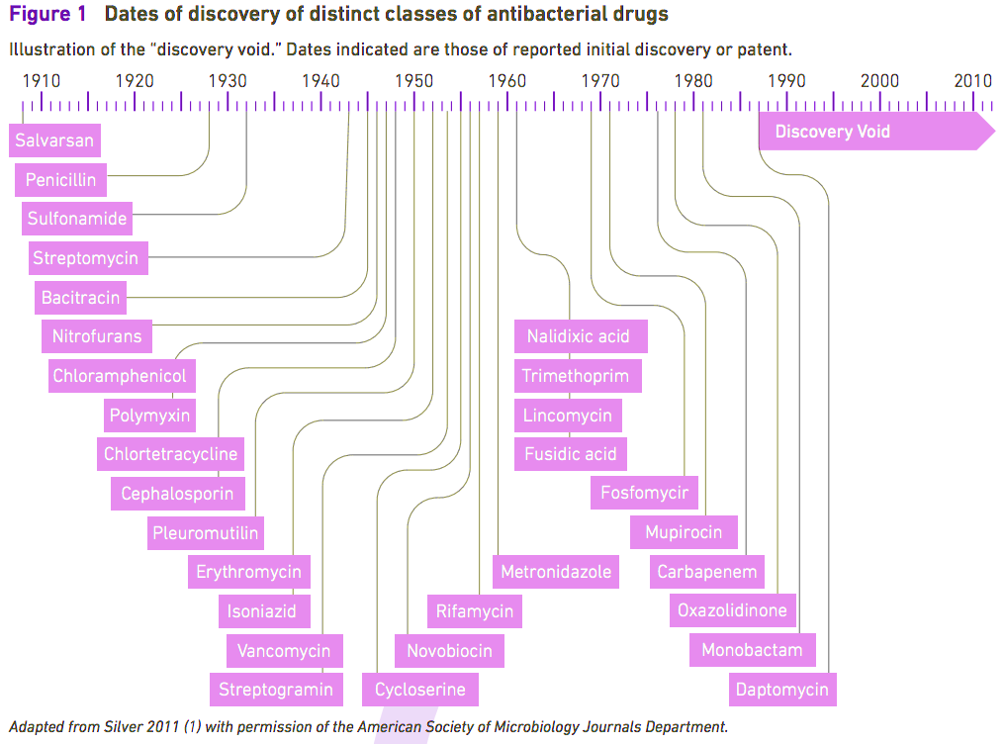

Slide 6
“One of the biggest issues is money “
http://www.bbc.com/news/health-35363569

Slide 7
Late-stage pipeline: systemic antibiotics recently approved, in registration or in phase III of clinical development
Drug (brand name) - Company | Antibiotic class | Activity spectrum/resistant pathogens targeted | Phase and indication¹ | Regulatory status
 |  |  |  | US | European Union
Ceftazidime+ avibactam | Cephalosporin + new BLI | Gram‒, including MDR P. aeruginosa, ESBL KPC | Approved February 2015 for cIAI in combination with metronidazole, and for cUTI in patients who have limited or no alternative treatment options, in phase III for HAP/VAP and cIAI | Approved Feb 2015 | Not submitted yet
Ceftolozane+ tazobactam | Cephalosporn + BLI | Gram‒, including carbapenem, piperacillin+tazobactam and ceftazidime-resistant Pseudomonas aeruginosa, ESBL | Approved for cUTI and cIAI, in phase III for VAP and phase I for paediatric use | Approved December 2014 | Under review since August 2014
Swiss Med Wkly. 2015;145:w14167

Slide 8
Late-stage pipeline: systemic antibiotics recently approved, in registration or in phase III of clinical development
Drug (brand name) - Company | Antibiotic class | Activity spectrum/resistant pathogens targeted | Phase and indication¹ | Regulatory status
 |  |  |  | US | European Union
Ceftobiprole | Cephalosporin | Gram+ and ‒, MRSA, VRSA, penicillin- and ceftriaxone-resistant Streptococcus pneumoniae, Enterobacteriaceae, P. aeruginosa | Approved for CABP and HAP, excluding VAP | Not submitted (additional phase III data required | Approved October 2013
Oritavancin | Glycopeptide | Gram+, including MRSA | Approved for ABSSSI, in phase I for paediatric use | Approved August 2014 | Approved May 2015
Dalbavancin | Glycopeptide | Gram+, including MRSA | Approved for ABSSSI, in phase III for CABP and phase I and III for paediatric use | Approved May 2014 | Approved March 2015
Swiss Med Wkly. 2015;145:w14167

Slide 9
Late-stage pipeline: systemic antibiotics recently approved, in registration or in phase III of clinical development.
Drug (brand name) - Company | Antibiotic class | Activity spectrum/resistant pathogens targeted | Phase and indication¹ | Regulatory status
 |  |  |  | US | European Union
Eravacycline | Tetracycline | Gram+ and ‒, including CRE, ESBL-producing strains, MDR Acinetobacter baumanii, VRE, MRSA | Phase III for cUTI and cIAI4 | NA | NA
Plazomicin | Aminogylcoside | Gram‒, including CRE | Phase III for bloodstream infection and nosocomial pneumonia caused by CRE5 | NA | NA
Delafloxacin | Fluoroquinolone | Gram+ and ‒, including MRSA | Phase III for ABSSSI | NA | NA
Solithromycin | Macrolide | Gram+, including macrolide-resistant strains | Phase III for CABP and uncomplicated gonorrhoea, in phase I for paediatric use | NA | NA
Swiss Med Wkly. 2015;145:w14167

Slide 10
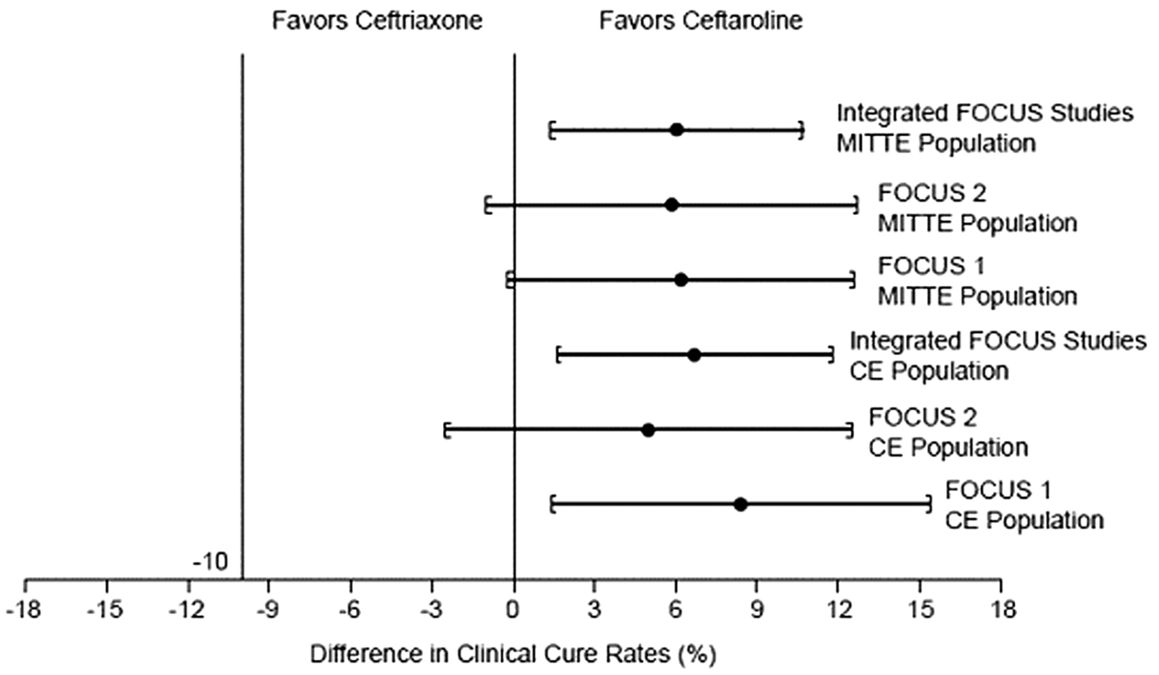
Confidence intervals for the difference in clinical cure rates at test-of-cure, individual and integrated community-acquired pneumonia studies (clinically evaluable [CE] and modified intent-to-treat efficacy [MITTE] populations)
Ceftaroline
Thomas M. File, Jr et al. Clin Infect Dis. 2010;51:1395-1405
Notes:
Confidence intervals for the difference in clinical cure rates at test-of-cure, individual and integrated community-acquired pneumonia studies (clinically evaluable [CE] and modified intent-to-treat efficacy [MITTE] populations). FOCUS, Ceftaroline Community Acquired Pneumonia Trial versus Ceftriaxone in Hospitalized Patients.

Slide 11
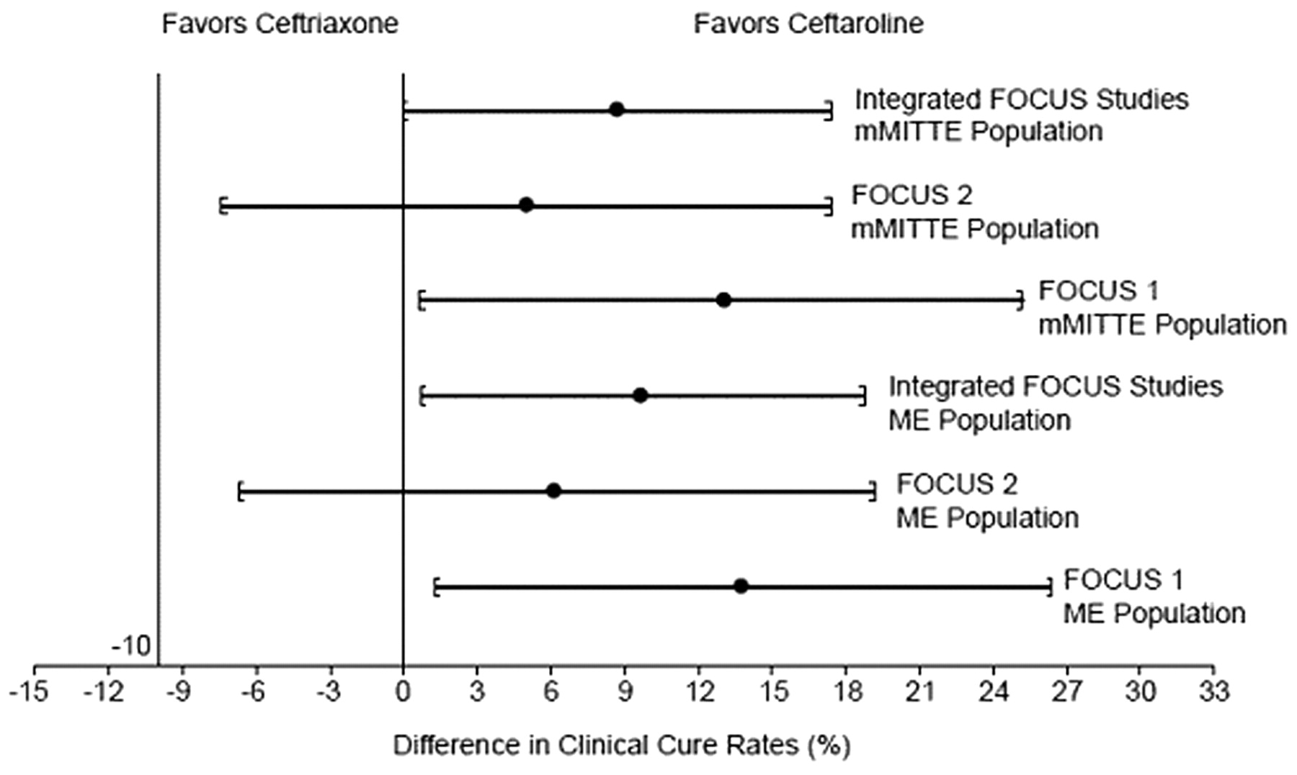
Confidence intervals for the difference in clinical cure rates at test-of-cure, individual and integrated community-acquired pneumonia studies (microbiologically evaluable [ME] and microbiological modified intent-to-treat efficacy [mMITTE] populations)
Ceftaroline
Thomas M. File, Jr et al. Clin Infect Dis. 2010;51:1395-1405
Notes:
Confidence intervals for the difference in clinical cure rates at test-of-cure, individual and integrated community-acquired pneumonia studies (microbiologically evaluable [ME] and microbiological modified intent-to-treat efficacy [mMITTE] populations). FOCUS, Ceftaroline Community Acquired Pneumonia Trial versus Ceftriaxone in Hospitalized Patients.

Slide 12
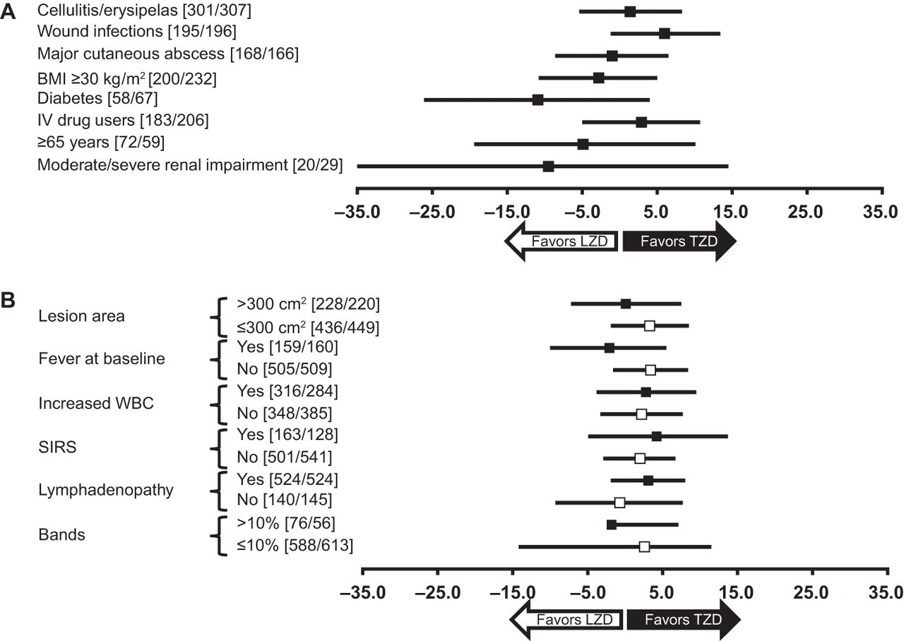
Differences in early clinical response between Tedizolid and linezolid according to clinically relevant host and disease factors (A) and baseline severity measures (B) in the ITT population
Andrew F. Shorr et al. Antimicrob. Agents Chemother. 2015;59:864-871
Notes:
Differences in early clinical response between tedizolid and linezolid according to clinically relevant host and disease factors (A) and baseline severity measures (B) in the ITT population. The results are the weighted (by study) difference and adjusted confidence interval. [n/n], number of subjects in the subgroup in the tedizolid arm/number of subjects in the subgroup in the linezolid arm. BMI, body mass index; ITT, intent-to-treat; IV, intravenous; LZD, linezolid; SIRS, systemic inflammatory response syndrome; TZD, tedizolid; WBC, white blood cell.

Slide 13
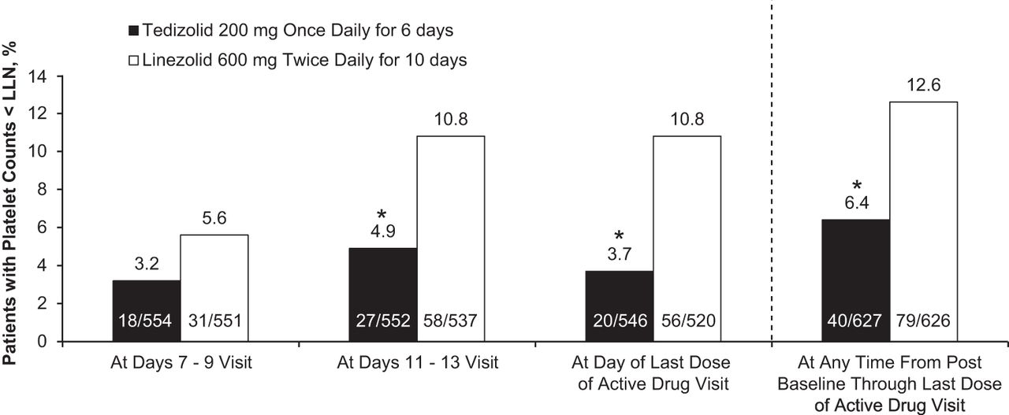
Patients with platelet counts below the lower limit of normal (LLN) (<150,000 cells/mm3) over time. *, P < 0.05
Andrew F. Shorr et al. Antimicrob. Agents Chemother. 2015;59:864-871
Notes:
Patients with platelet counts below the lower limit of normal (LLN) (<150,000 cells/mm³) over time. *, P < 0.05. EOT, end-of-therapy.

Slide 14
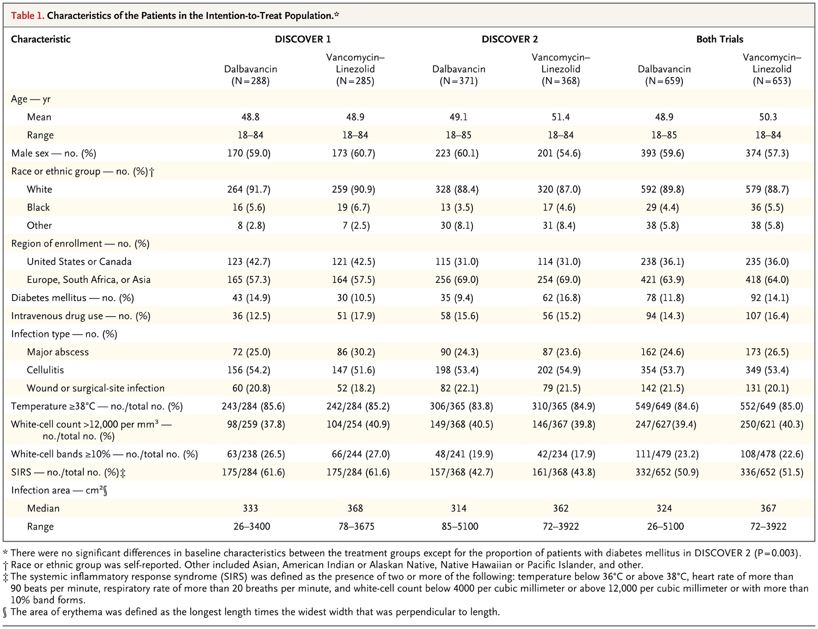
Characteristics of the Patients in the Intention-to-Treat Population
Boucher HW et al. N Engl J Med 2014;370:2169-2179
Once-Weekly Dalbavancin versus Daily Conventional Therapy for Skin Infection
N Engl J Med 2014;370(23):2169-2179
Notes:
Table 1 Characteristics of the Patients in the Intention-to-Treat Population.

Slide 15
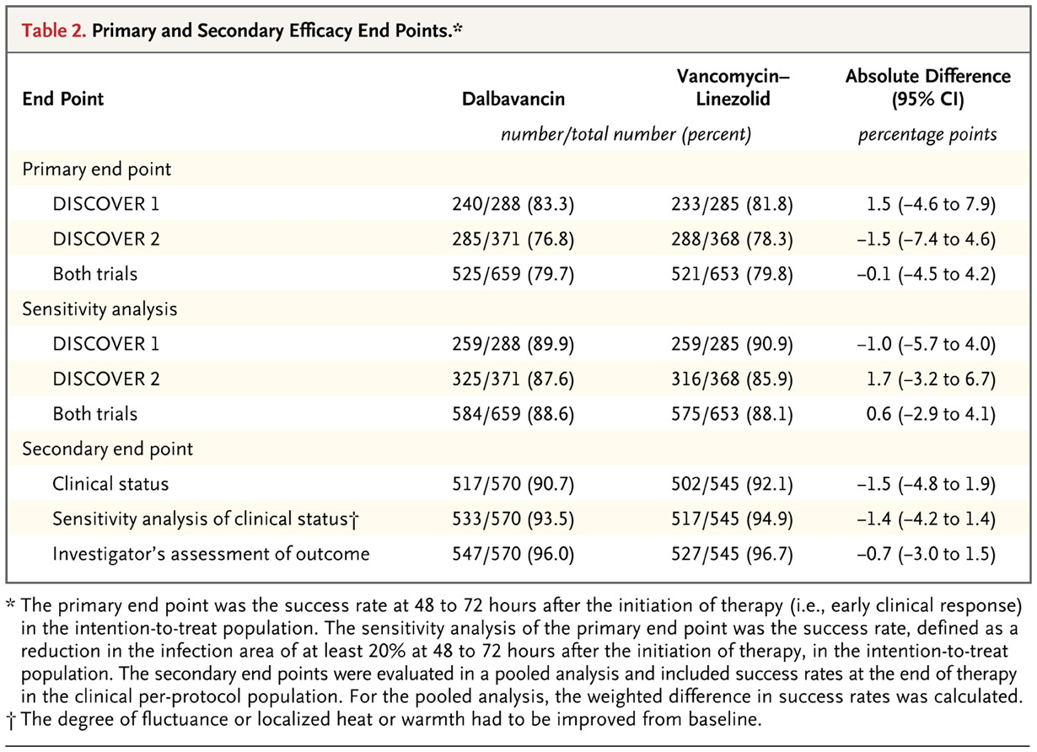
Primary and Secondary Efficacy End Points
Boucher HW et al. N Engl J Med 2014;370:2169-2179
Once-Weekly Dalbavancin versus Daily Conventional Therapy for Skin Infection
N Engl J Med 2014;370(23):2169-2179
Notes:
Table 2 Primary and Secondary Efficacy End Points.

Slide 16
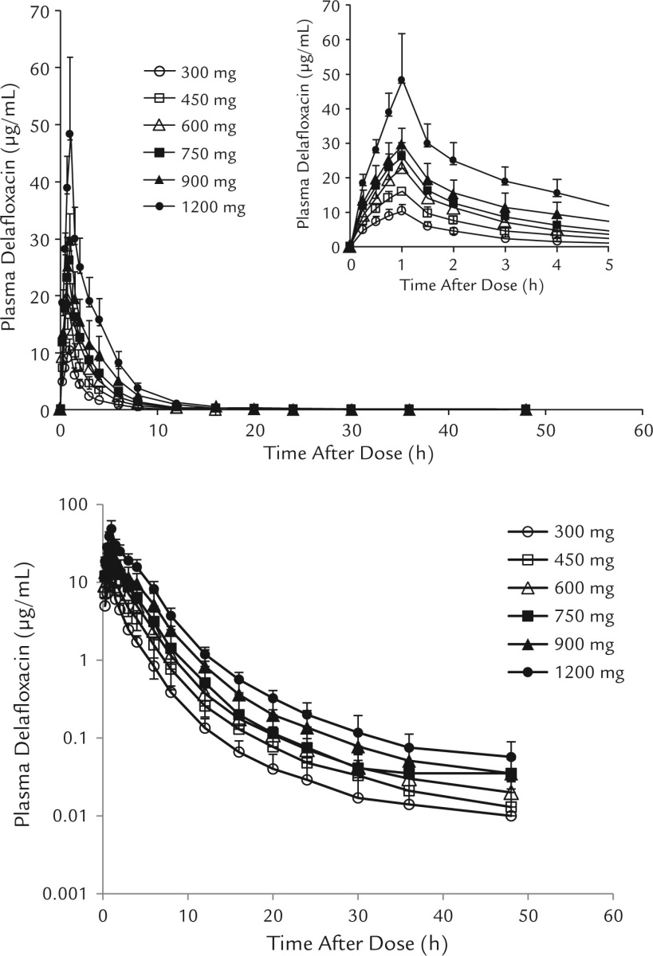
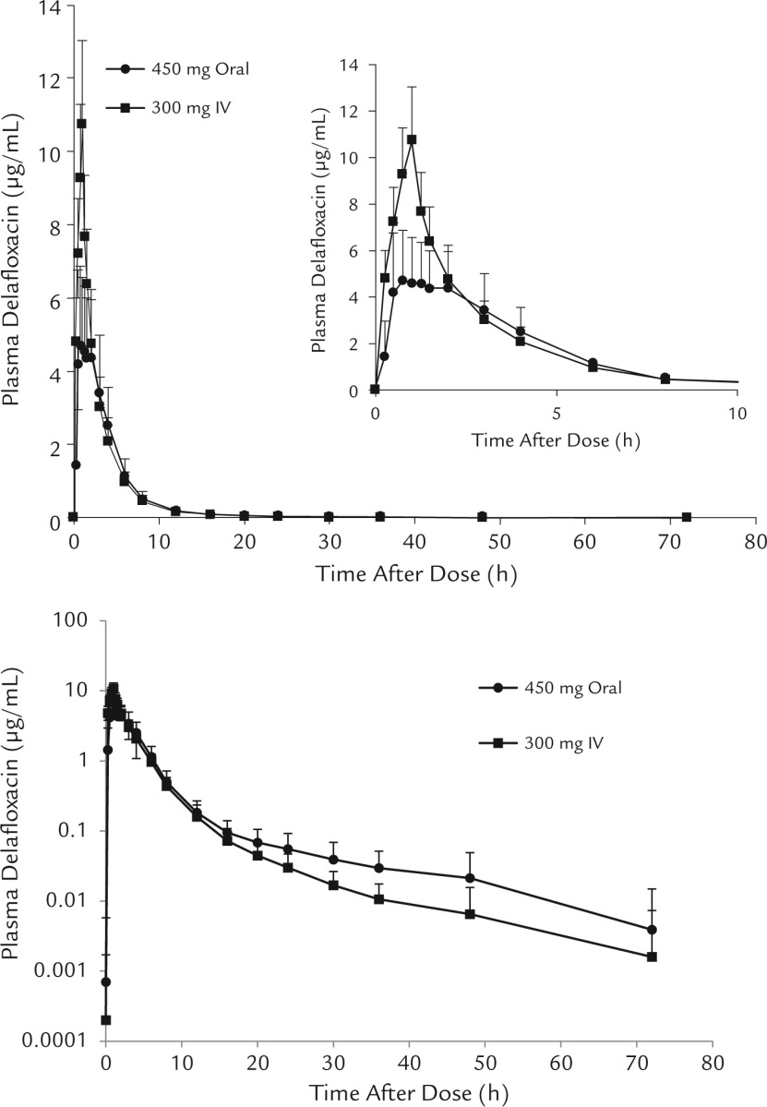
Safety, Tolerability, and Pharmacokinetic Properties of Intravenous Delafloxacin After Single and Multiple Doses in Healthy Volunteers
Hoover R. et al Clin Ther 2016 Jan 1;38(1):53-65.

Slide 17
A randomized, double-blind, Phase 2 study to evaluate subjective and objective outcomes in patients with acute bacterial skin and skin structure infections treated with Delafloxacin, linezolid or vancomycin
Kingsley J. J Antimicrob Chemother. 2016 Mar;71(3):821-9.

Slide 18
Ceftazidime-avibactam activity against multidrug-resistant Pseudomonas aeruginosa isolated in U.S. medical centers in 2012 and 2013
Antimicrob Agents Chemother. 2015;59(6):3656-9

Slide 19
¿Que es nuevo?

Slide 20
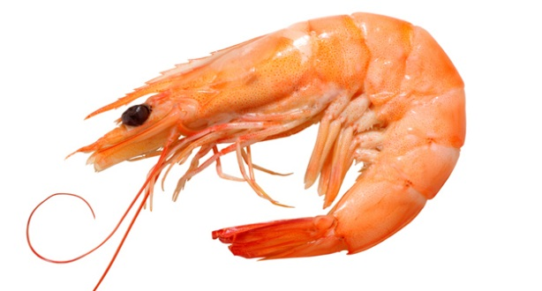
Bubba: “como te decía…el camarón es la fruta del mar”
Puedes…
barbecue it
boil it,
broil it
bake it,
saute it
shrimp-kabobs
shrimp creole
shrimp gumbo
Pan fried
deep fried
stir-fried
pineapple shrimp
lemon shrimp
coconut shrimp
pepper shrimp
shrimp soup
shrimp stew
shrimp salad
shrimp and potatoes
shrimp burger
shrimp sandwich
“y creo que eso es todo”
Oxazolidinonas
Tedizolid
Cadazolid
Beta lactámicos
Ceftarolina
Ceftobiprole
Ceftazidima AVB
Imipenem/relebactam
Meropenem/RPX7009
Aminoglucósidos
Plazomicina
Fluoroquinolonas
Tetraciclinas
Delafloxacino
Omadaciclina
Eravaciclina

Slide 21
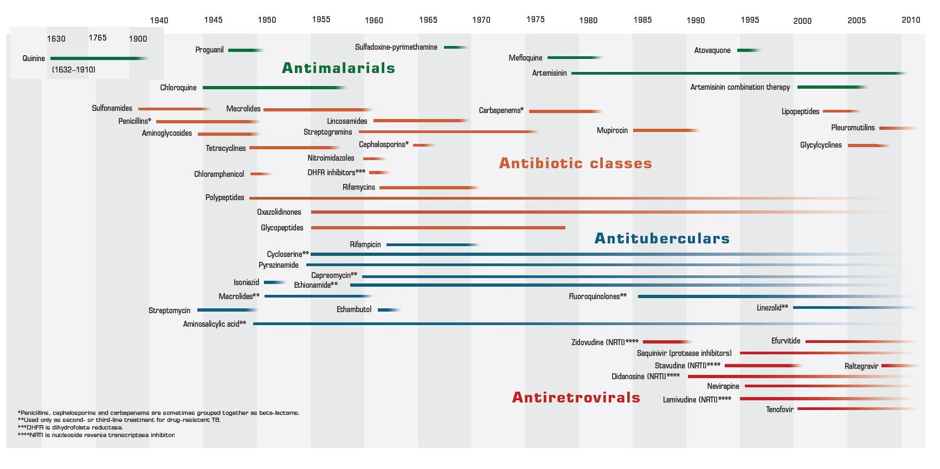
Uso clínico ÷ resistencia

Slide 23
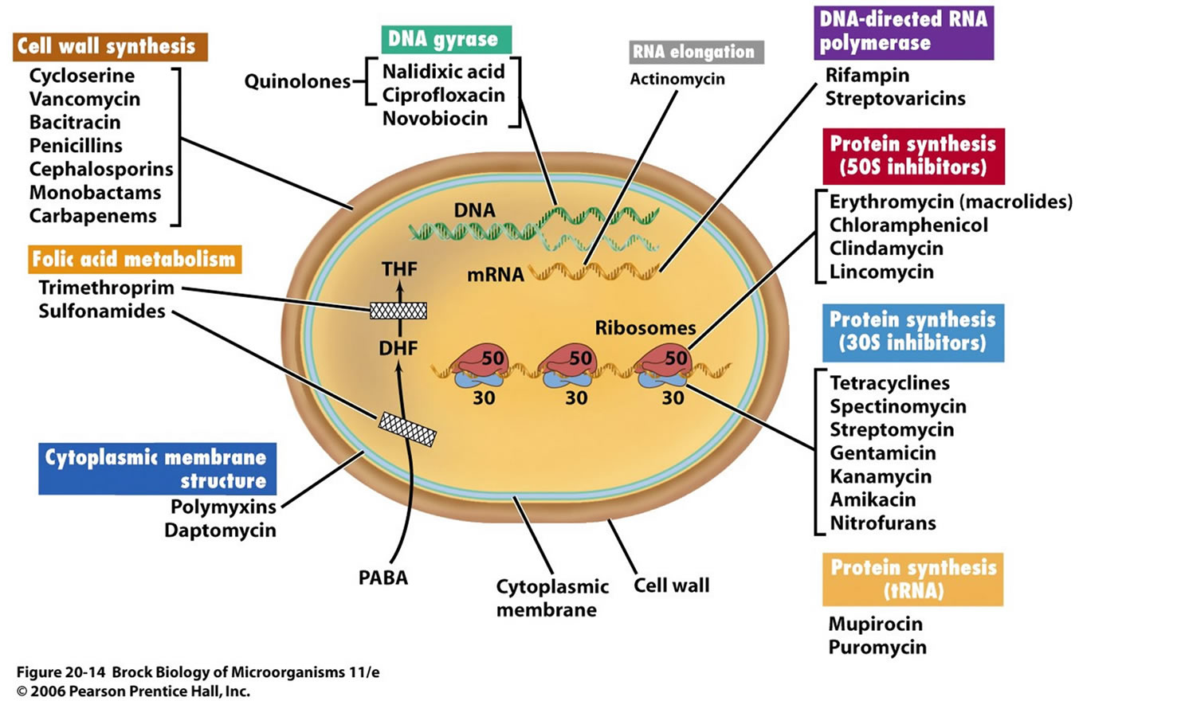

Slide 24
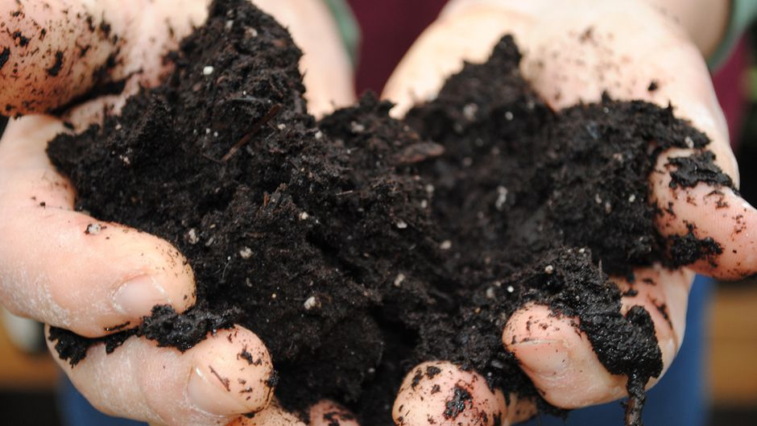
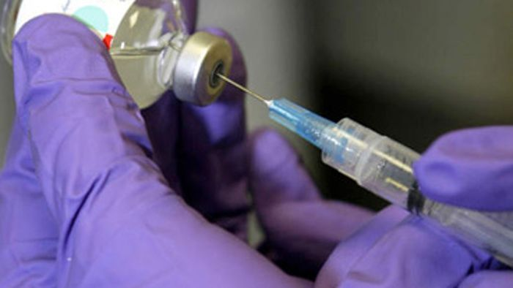
Waskman screening Platform

Slide 25
iChip
10,000 extractos
vs S aureus
Eleftheria terrae
(aquabacteriace) 16S DNA
Teixobactin

Slide 26
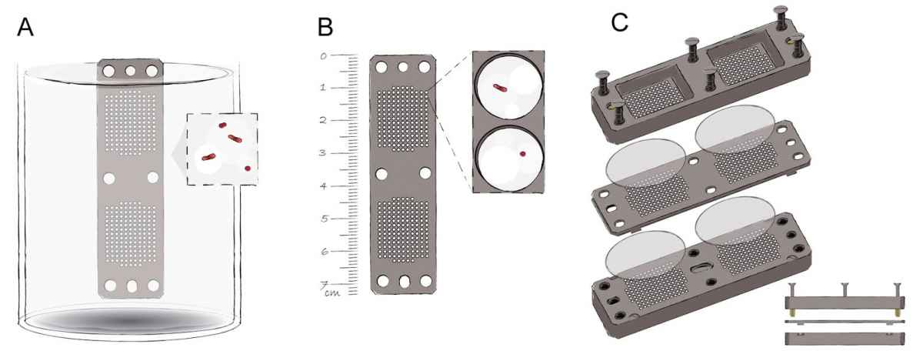
IChip
http://www.popsci.com/ichip-new-way-find-antibiotics-and-other-key-drugs

Slide 27
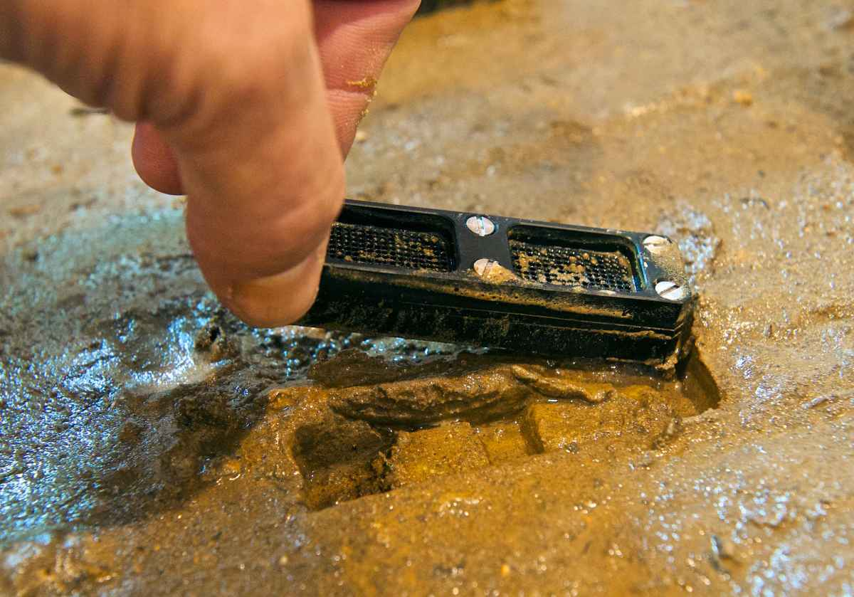
http://www.popsci.com/ichip-new-way-find-antibiotics-and-other-key-drugs

Slide 28
Teixobactina vs Vancomicina
Nature. 2015 Jan 22;517(7535):455-9

Slide 29
¿En qué etapa funciona?
Eleftheria terrae
Incorporación de 3H-thimidina (DNA), 3H- uridina (RNA), 3H-leucina (protein), and 3H- glucosamina (peptidoglucano)
S. aureus
Nature. 2015 Jan 22;517(7535):455-9

Slide 30
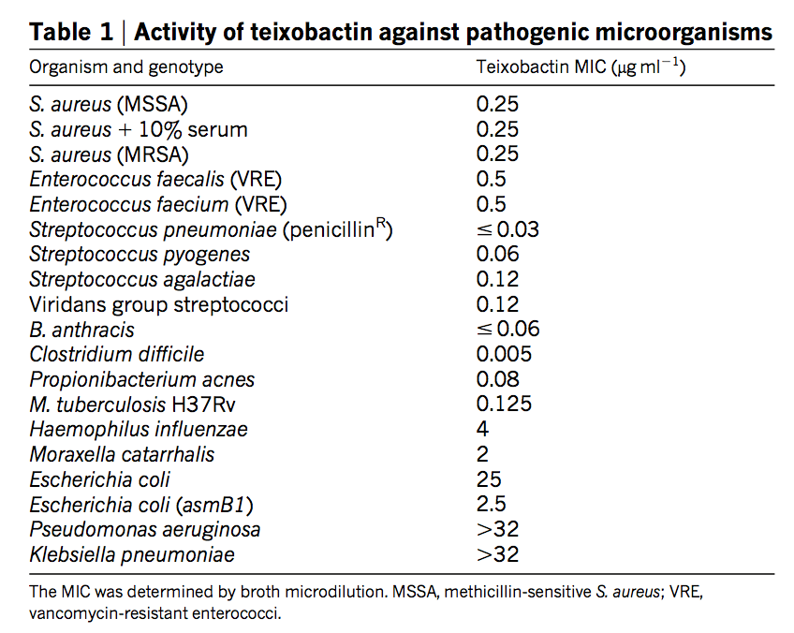
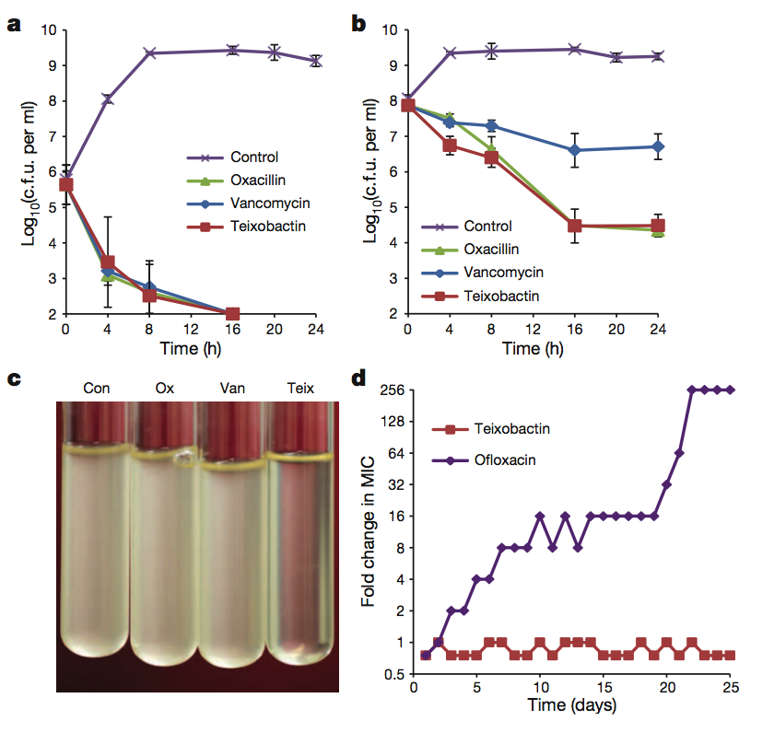
Cocos, bacilos y Micobacterias….pero no BGN
Nature. 2015 Jan 22;517(7535):455-9

Slide 31
¿Antirretrovirales para tratamiento antibacteriano?
Paso 1
LukED
+
Linf-TCD4
+
CCR5
Paso 2
Antagonistas de CCR5 (Maraviroc)
Impide lisis de CCR5(+)
Paso 3
LukED purificado aplicado a ratones
Ccr5 –/–
Ccr5 +/+
Alonzo, F. et al. CCR5 is a receptor for Staphylococcus aureus leukotoxin ED.
Nature 493, 51–55 (2013)

Slide 32
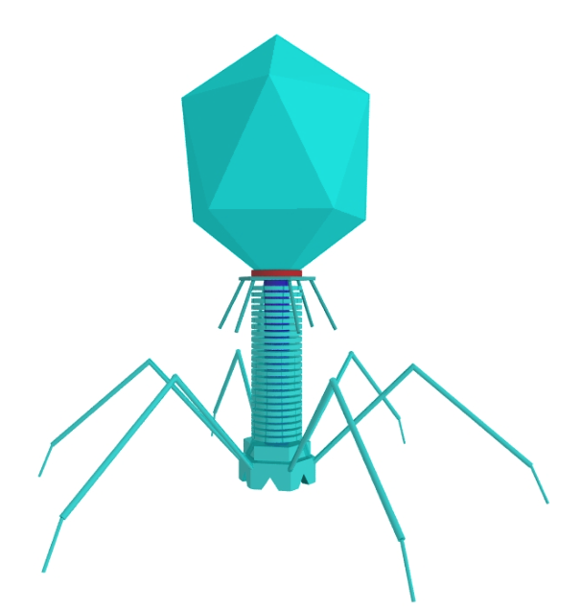
Lisozimas: Actividad vs N-acetilmuramolhidrolases que hidrolisan la fracción de unión β (1,4) glucosidica entre el acíso N-acetil- muramico y N-acetilglucosamina
G -
Listeria PlyP35
P. aeruginosa KZ144
Bacillus amyloliquefaciens Lys1521
G +
Artilisinas
Endolisinas
Permeabilizador de ME
Future Microbiol. (2015) 10(3), 377–390

Slide 33
Antibodies to watch in 2015.MAbs. 2015;7(1):1-8

Slide 34
Nuevas Moléculas
¿Existen?
¿Serán eficaces?
Pocas
No hay blancos diferentes
Duraran poco

Slide 35
Nuevas Moléculas
¿Existen?
¿Serán eficaces?
No lo sé
Lo que si sé es que necesitamos buscar nuevos blancos de acción
el panorama es sombrío si no cuidamos lo que tenemos

Slide 36
Gracias

